Slide 1
Section H
Protein synthesis
杨国栋
Yang Guodong
Biochemistry and Molecular Biology, College of Life Sciences
gdyang@sdau.edu.cn
13854808762

Slide 2
H1 The genetic code
H2 Translation in prokaryotes
H3 Translation in eukaryotes
H4 Protein Targeting
H5 Protein Glycosylation

Slide 3
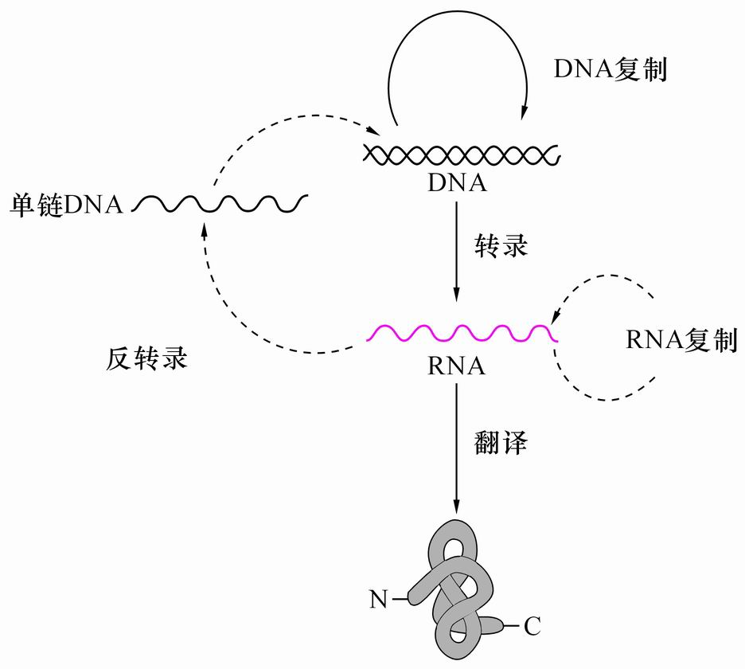
Genetic Central Dogma
遗传中心法则

Slide 4
Brief history of discovery of genetic central dogma
1865年，孟德尔完成长达8年的豌豆实验。
1902年，美国生物学家萨顿和鲍维里通过观察细胞的减数分裂时又发现染色体是成对的，并推测基因位于染色体上。
1928年 , 摩尔根发现了基因的连锁与交换。
1944年，Oswald T. Avery首次证明DNA是基因的载体（遗传信息的载体）
1950,1953年，Barbara Mclintock 发现跳跃基因transposon.
1953年，Watson and Crick DNA double helix
Semiconservative replication–for high fidelity of DNA replication
1955 年，Francis Crick raised a purely theoretical adaptor hypothesis to explain how sequences of four nucleotides in a nucleic acid template determine sequences of 20 amino acids in proteins.
1958年， Francis Crick genetic central dogma (The concept of messenger RNA (mRNA) was boldly formulated by Jacob and Monod in 1961)

Slide 5
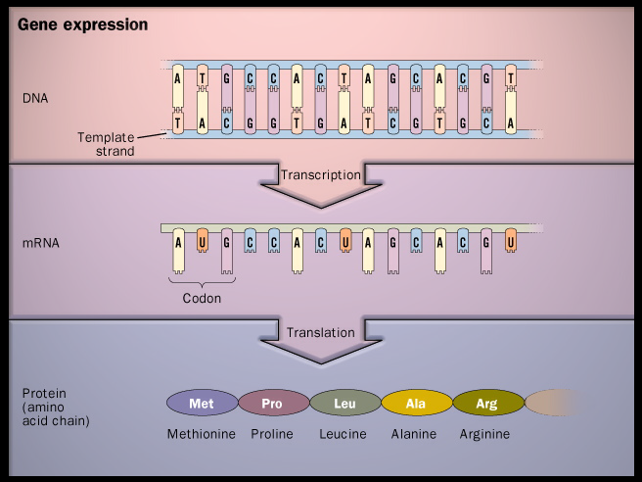
Genetic code
tRNA / anticodon

Slide 6
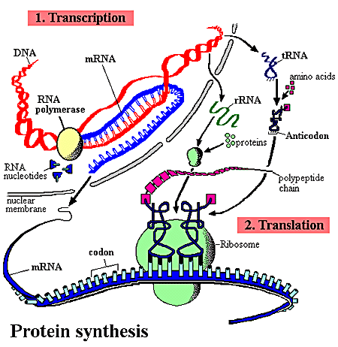

Slide 7
1. Translation (protein synthesis) necessitates the coordinated interplay of about 300 macromolecules in the cells
The most complex of all biosynthetic pathways.
60 to 90 macromolecules for making up the protein-synthesizing machine ribosomes
Over 20 enzymes for activating the amino acids.
Over 10 auxiliary proteins for the initiation, elongation and termination of the polypeptide chains.
Account for up to 90% of the chemical energy used by a cell for all biosynthetic reactions.

Slide 8
The molecules used for translation account for more than 35% of the cell’s dry weight.
However, proteins are synthesized with very high efficiency: a complete polypeptide chain of 100 residues is synthesized in about 5 seconds in an E.coli cells at 37ºC.

Slide 9
2. The molecular mechanism of protein synthesis was mainly revealed during the 2nd half of the 20th century
Ribonucleoprotein particles (were later called ribosomes) were revealed to be the site of protein synthesis in rat liver cells, using radioactively labeled amino acids and immediate subcellular fractionations (early 1950s, by Zamecnik).
Amino acids were found to be activated by attaching to a special form of heat-stable RNA molecules (later called tRNAs) before being incorporated into polypeptides (1950s, by Hoagland and Zamecnik).

Slide 10
Each tRNA molecule was found to function as an adapter (originally hypothesized by Francis Crick), carrying a specific amino acid with one site and recognizing a specific site on a template with another site.
The concept of messenger RNA (mRNA) was boldly formulated by Jacob and Monod in 1961: a short-lived RNA should serve as the information carrier between gene and protein (to explain the quick induction of proteins in E.coli).
This bold hypothesis was quickly confirmed by studies of E.coli cells infected by T₂ phages .

Slide 11
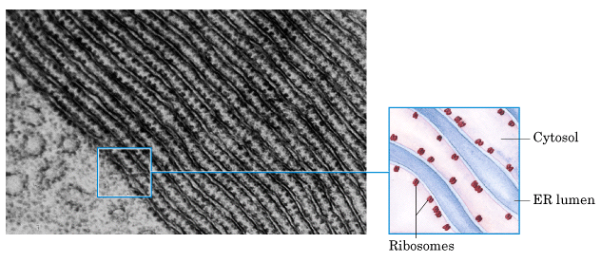
Ribosomes were revealed to be the site of
protein synthesis in early 1950s (pulse
labeling with radioactive amino acids and
subcellular fractionations).

Slide 12
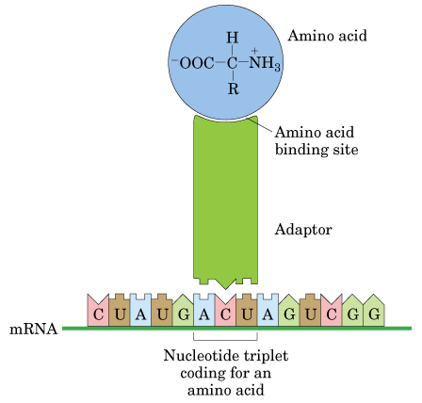
Crick’s
adapter
hypothesis
Hydrogen
bonds

Slide 13
H1 The genetic code

Slide 14
1. Amino acids in a polypeptide chain were found to be coded by groups of three nucleotides in a mRNA
Simple calculation indicated that three or more bases are probably needed to specify one amino acid.
Genetic studies of insertion, deletion, and substitution mutants showed codons for amino acids are triplet of nucleotides; codons do not overlap and there is no punctuation between codons for successive amino acid residues.
The amino acid sequence of a polypeptide is defined by a linear sequence of contiguous codons: the first codon establishs a reading frame.

Slide 15
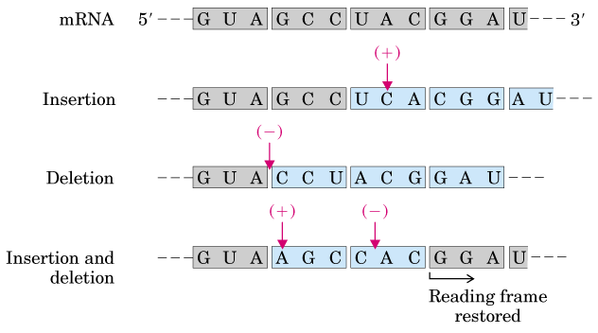
Altered amino acid sequences
Genetic studies showed that genetic
codons are successive triplets of nucleotides

Slide 16
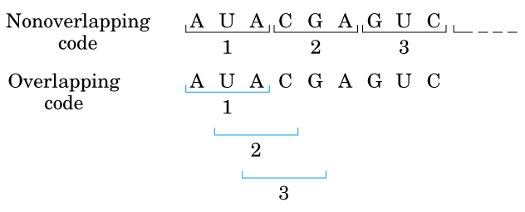
√
X

Slide 17
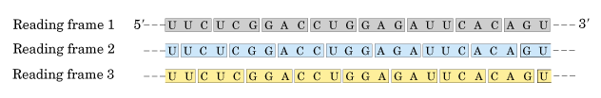
Each mRNA molecule would have three
potential reading frames (but only one
usually codes for a polypeptide chain) .

Slide 18
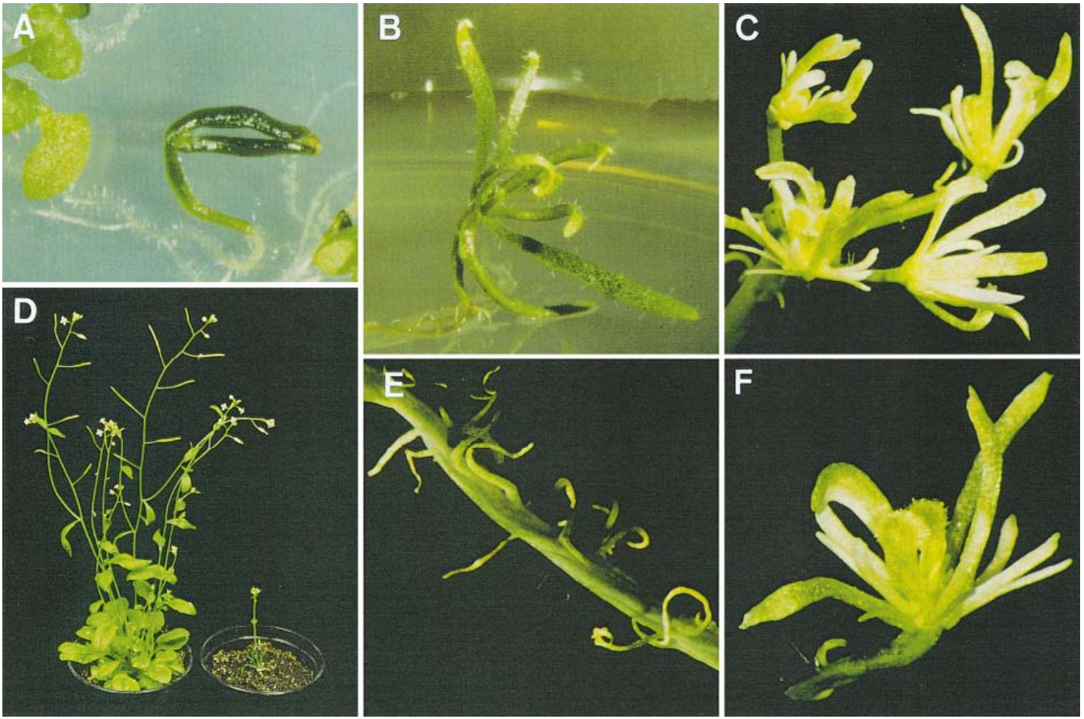
Arabidopsis Argonaute 1 (AGO 1)
WT mutant
ago1 mutant phenotype

Slide 19
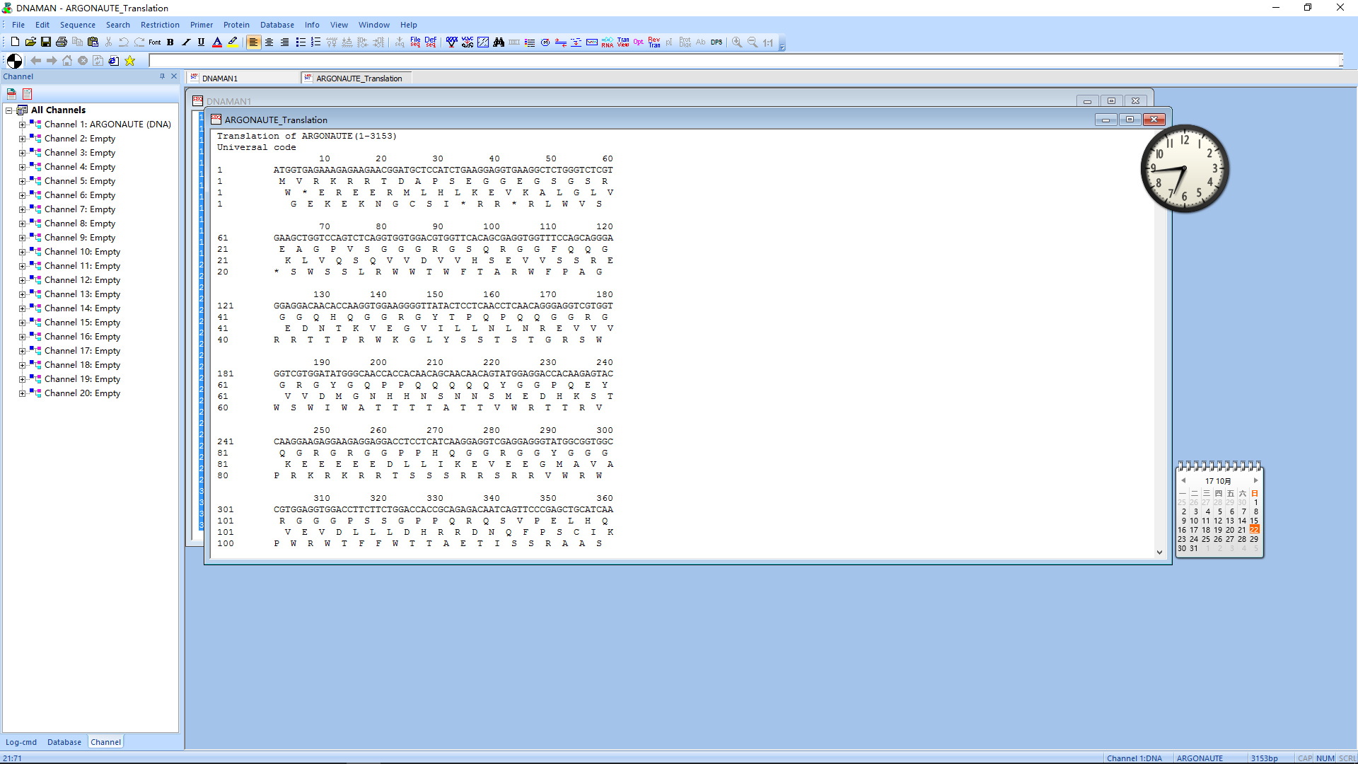

Slide 20
2. All 64 triplet codes were deciphered by 1966
61 of the codons code for the 20 amino acids and three (UAA, UAG, UGA) for chain termination (called termination codons, stop codons, or nonsense codons).
AUG is a dual codon coding for initiation and Met.
18 of the amino acids are coded by more than one codon: the genetic codes are degenerate (兼并性）. (Having more than one codon specify the same amino acid.)
Condons that specify the same amino acid (synonyms) often differ only in the third base, the wobble（变偶or 摆动）position, where base-pairing with the anticodon may be less stringent than for the first two positions of the condon.

Slide 21
The codes seem to have evolved in such a way to minimize the deleterious effects of mutations, especially at the third bases: XYU and XYC always encode the same amino acid XYA and XYG usually code for the same amino acid.
A reading frame codes for more than 50 amino acids without a stop codon is called an open reading frame(ORF), which has the potential of encoding a protein.

Slide 22
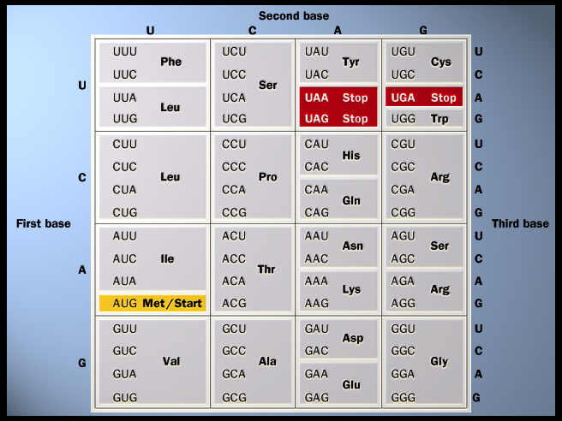

All 64
genetic
codes

Slide 23
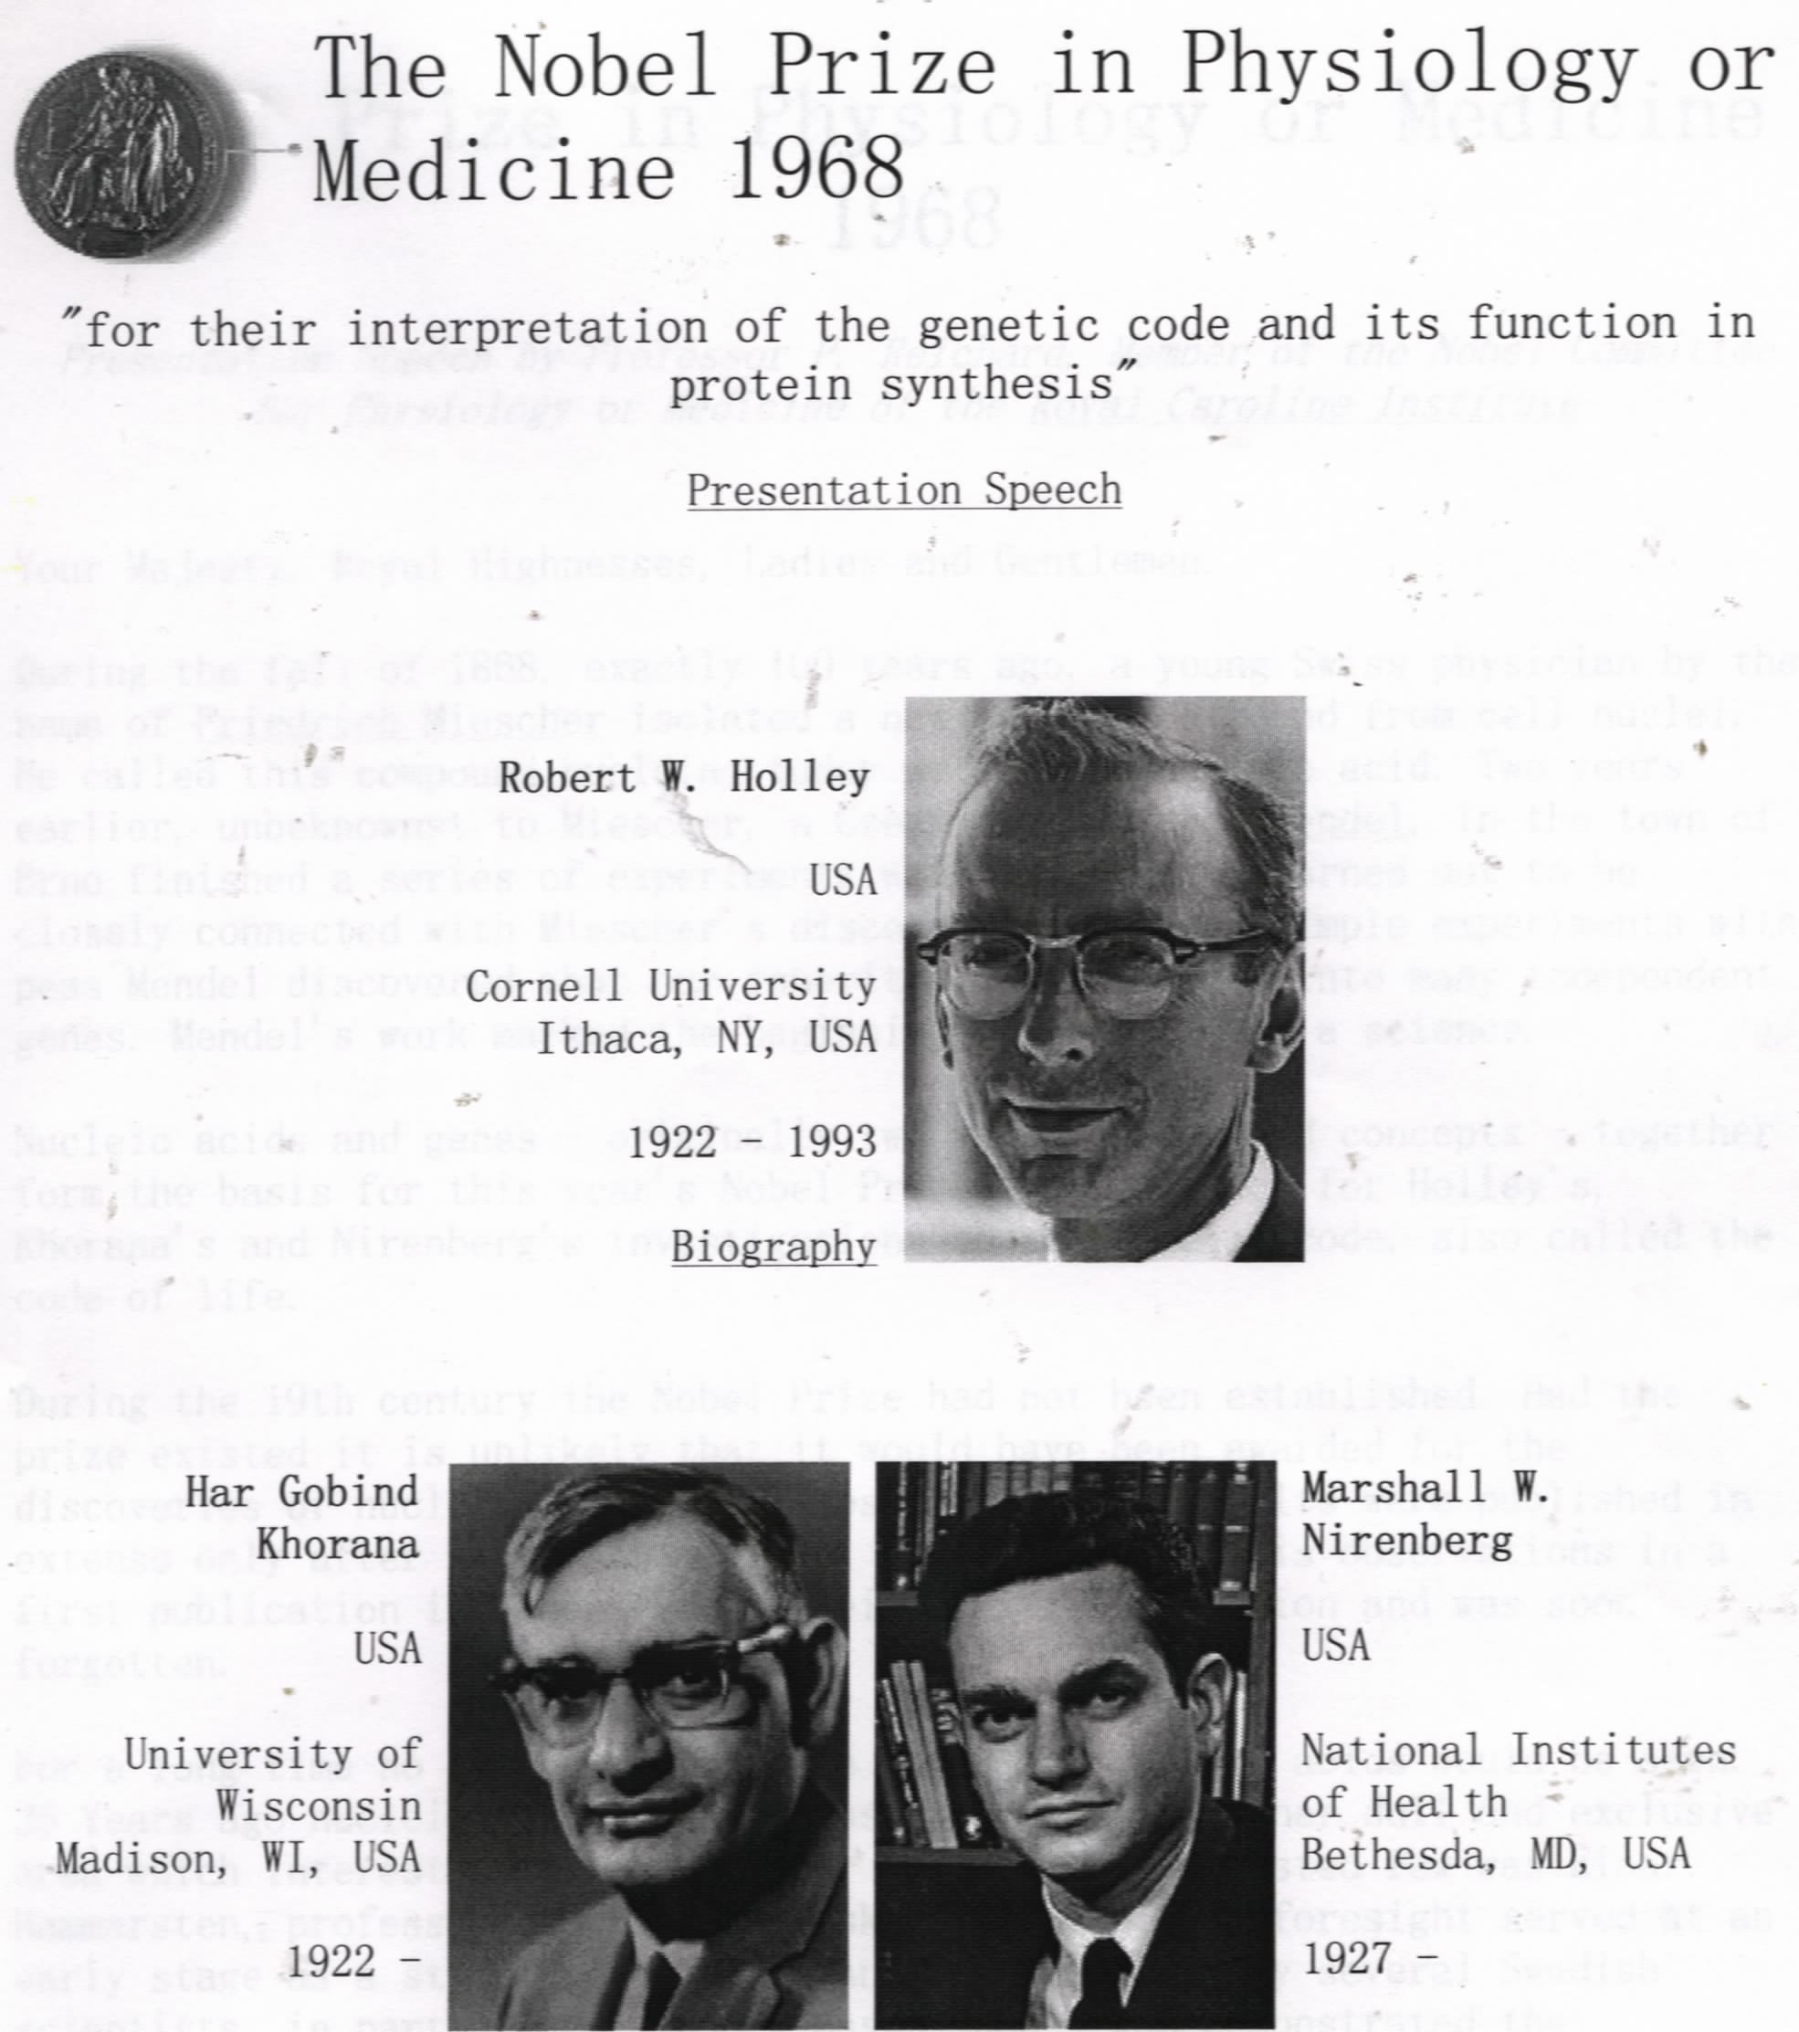
Established
the chemical
structure of
tRNA
Established the in
vitro system for
revealing the
genetic codes
Devised methods
to synthesize RNAs
with defined
sequences

Slide 24
3. The genetic code has been proved to be nearly(not absolutely) universal
Direct comparisons of the amino acid sequences of proteins with the corresponding base sequence of their genes or mRNAs, as well as recombinant DNA technologies, proved that the genetic codes deciphered from in vitro studies were correct and almost universally applicable.
A small number of “unusual codes” have been revealed in many mitochondria genomes and nuclear genome of a few organisms.

Slide 25
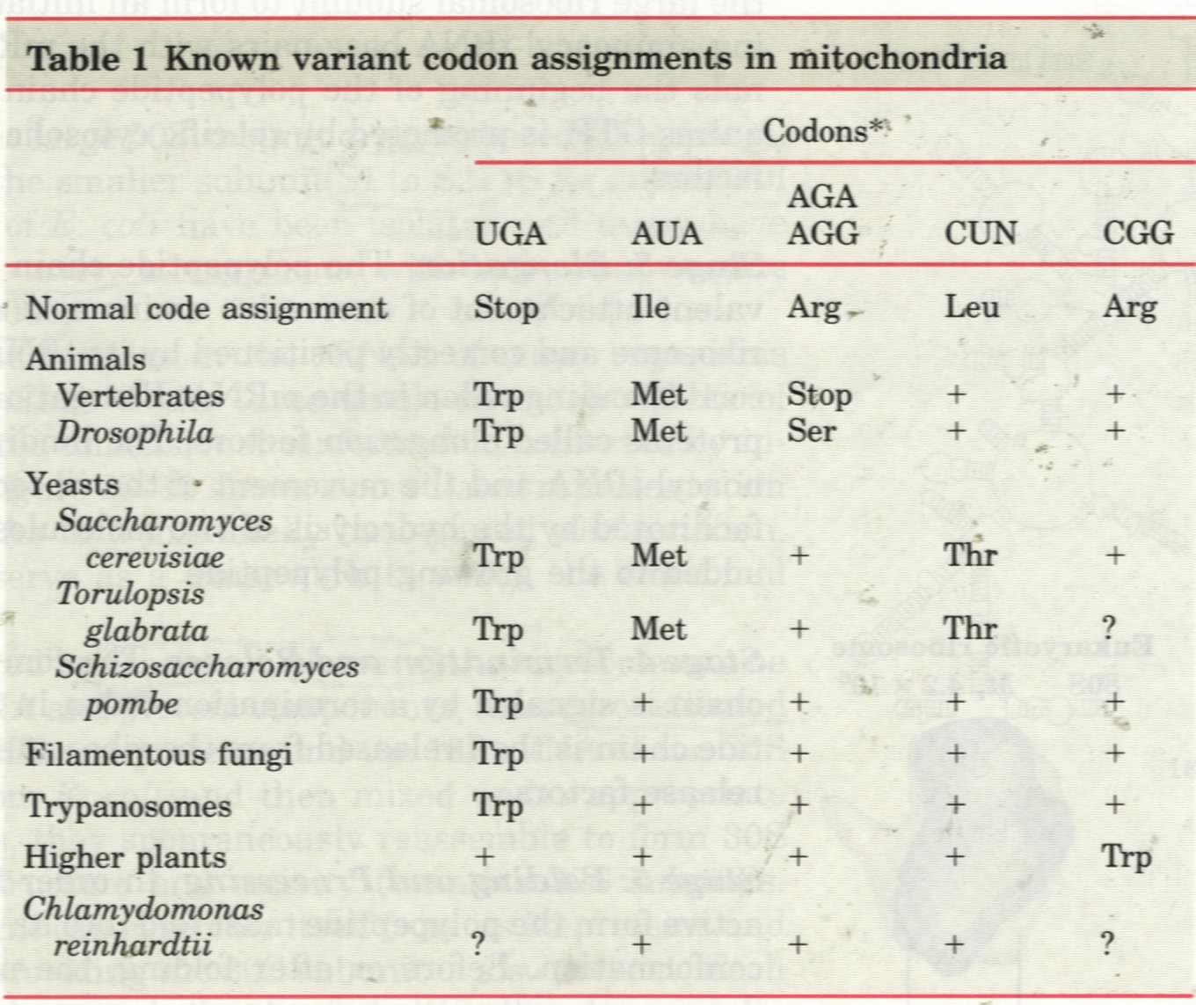

Slide 26
The features of genetic codon：
方向性 (5’-3’ direction)
读码的连续性，非重叠(successive triplets/ no overlap )
兼并性(degenerate)
变偶性(wobble)
起始密码和终止密码(start and stop codons)
通用性与例外 (universal /unusual codes)

Slide 27
H2 Translation in prokaryotes

Slide 28
1. Three kinds of RNA molecules perform different but cooperative functions in protein synthesis
mRNAs carry the genetic information copied from DNA in the form of genetic codons.
tRNAs mediate the incorporation of specific amino acids according to genetic codons present on the mRNA molecules via their specific anticodon triplets.
rRNAs associate with a set of proteins to form the protein-synthesizing machines (ribosomes) and probably catalyze peptide bond formation during protein synthesis.

Slide 29
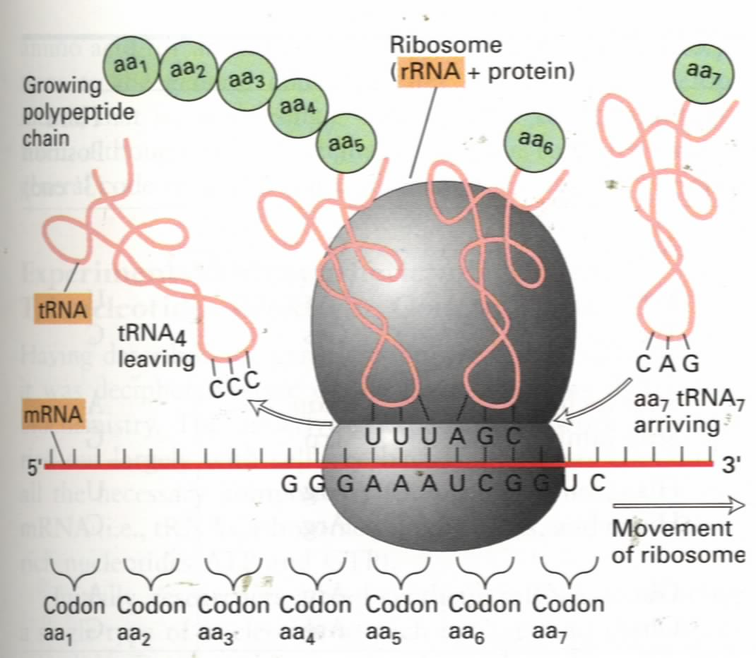

Slide 30
2. All tRNAs have common structural features: cloverleaf in secondary, “L” in 3-D structures.

Slide 31
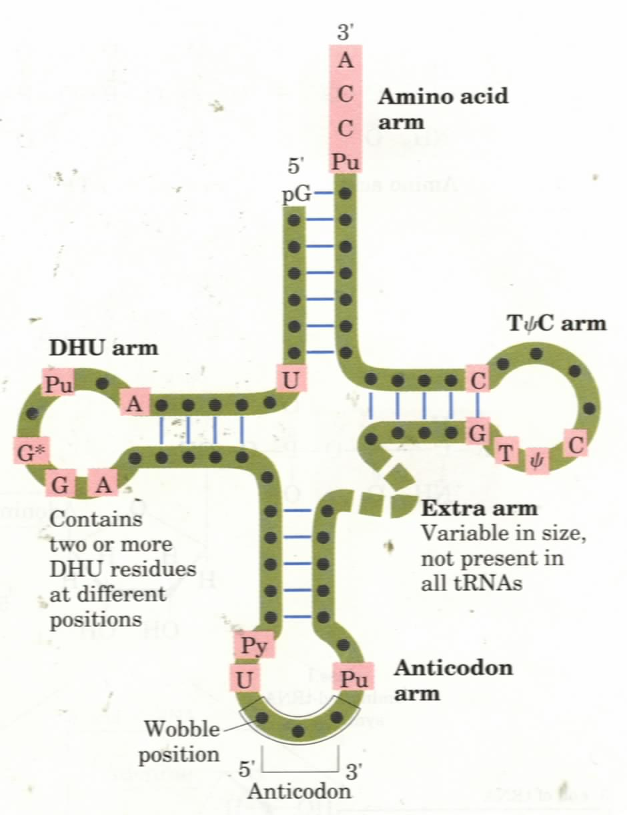
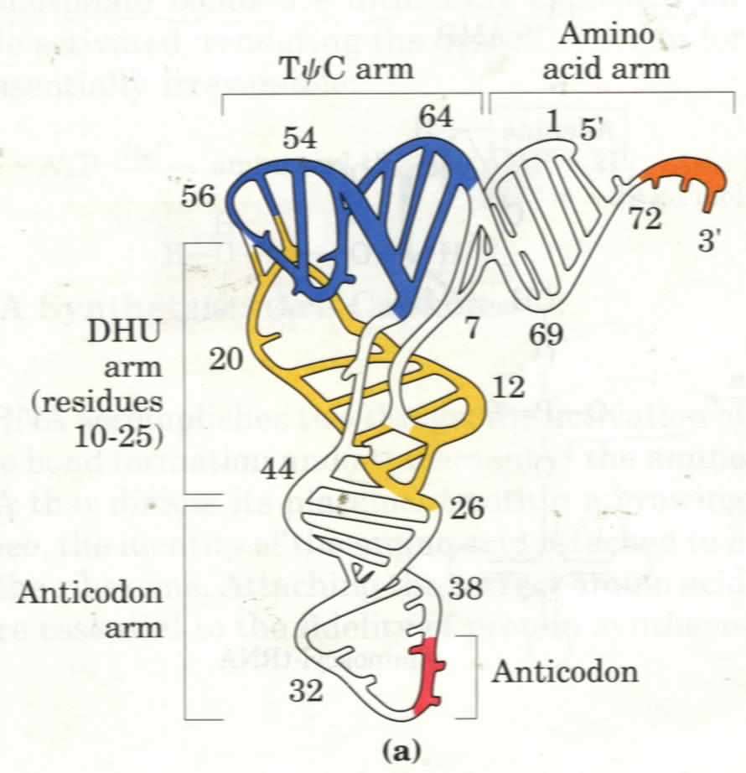

Slide 32
3. Some tRNA molecules can recognize more than one codons via wobble pairing
The adapter tRNAs recognize the codons on a mRNA via a triplet called anticodons.
It was first proposed that a specific tRNA anticodon would exist for every of the 61 (or 64) codons, but less tRNAs were revealed.
It was revealed that highly purified tRNA molecules (e.g., alanyl-tRNA^{Ala}) of known sequence could recognize several different codons.
Inosine （I, 次黄嘌呤）, which may form base pair with A, U, and C, was found to be present at the first position of the anticodons in some tRNAs.

Slide 33
Crick proposed the “wobble hypothesis” in 1966 to explain the pairing features between anticodons and codons:
  The first two bases of a codon in mRNA confer most of the coding specificity, the third base can be loosely paired with the anticodons;
  The first base of some anticodons can wobble and determines the number of codons a given tRNA can read (A and C for one, U and G for two, I for three);
  Codons that specify the same amino acid but differ in either of the first two bases need different tRNAs, i.e., a mininum of 31 tRNA are needed to translate the 61 codons;

Slide 34
This hypothesis has been widely supported by all the evidence gathered (thus the “wobble rule”).
This moderate pairing strength may serve to optimize both the accuracy and speed of polypeptide synthesis.

Slide 35
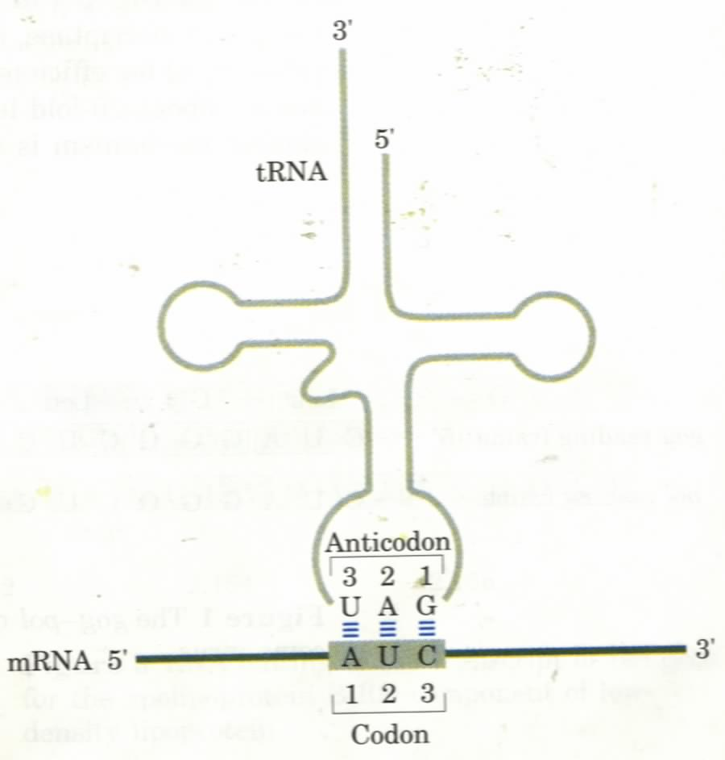
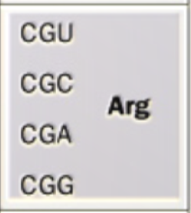
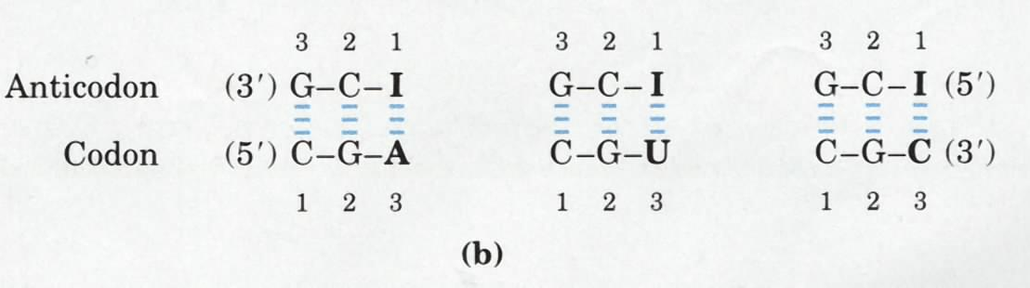
AA
The codon-anticodon pairing between the a mRNA and a
tRNA: the presence of an inosinate residue at position one
in the anticodon allows the tRNA to recognize a few codons.

Slide 36
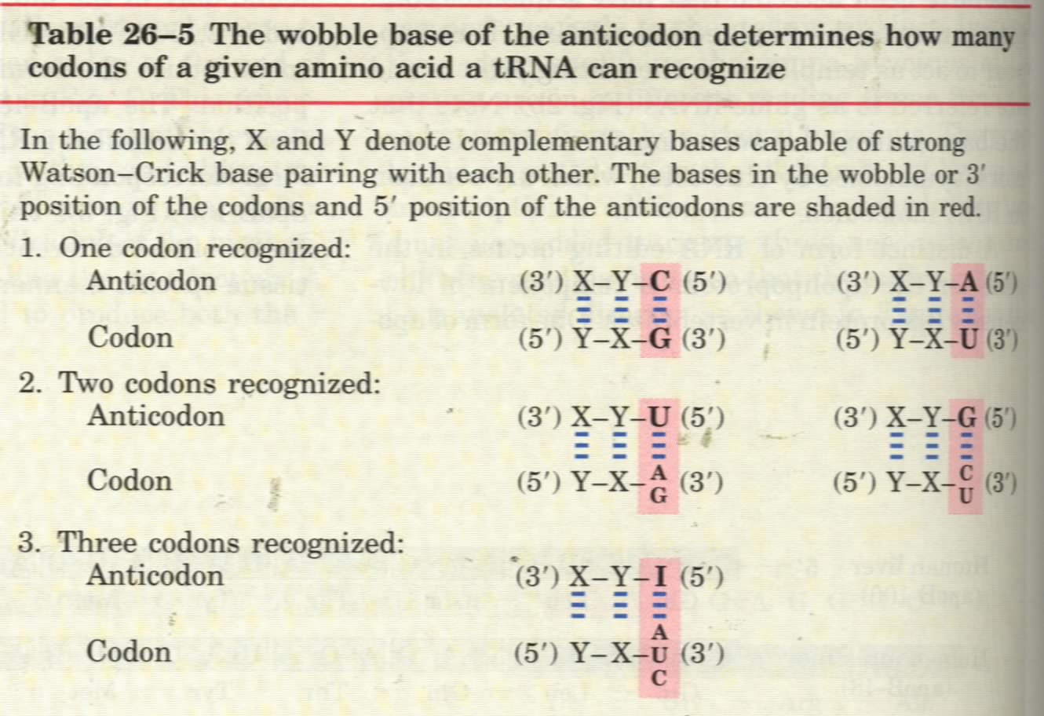

Slide 37
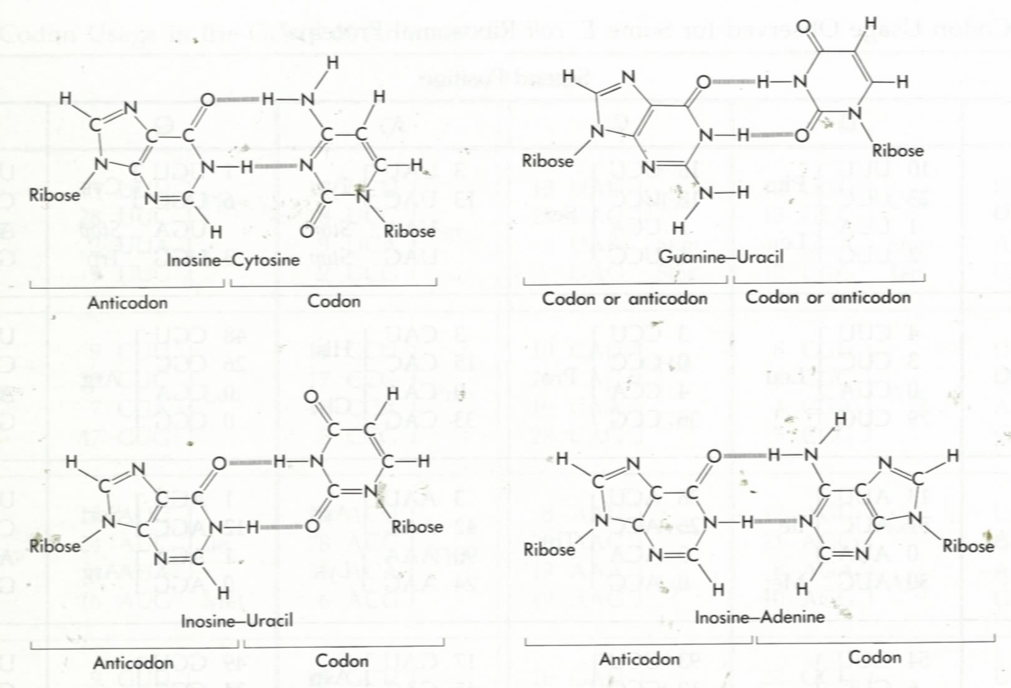
U
G
I
C
Possible wobble pairing between anticodon and codon.
U
I
I
A

Slide 38
它们之间的对应关系？
氨酰tRNA合成酶
codon
tRNA
AA

Slide 39
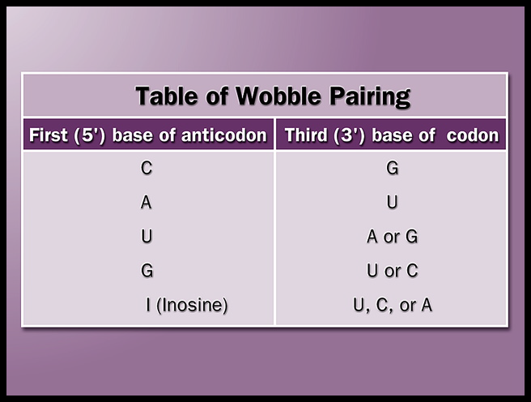

Slide 40
Genetic code
tRNA / anticodon

Slide 41
小结：
遗传密码的基本性质
（the features of genetic codon）;
2. Anticodons wobble hypothesis

Slide 42
4. The synthesis of a protein can be divided into five stages
Each amino acid is first covalently attached to a specific tRNA molecule in a reaction catalyzed by a specific aminoacyl-tRNA synthetase (Stage 1氨基酸的活化 （Activation of Amino Acids）).
The mRNA then binds to the smaller subunit of the ribosome, after which the initiating aminoacyl-tRNA and the large subunits of the ribosome will bind in turn to form the initiating complex (Stage 2合成的起始（initiation）)

Slide 43
The first peptide bond is then formed after the second aminoacyl-tRNA is recruited with help of the elongation factors, and the chain is then further elongated (stage 3 合成的延伸（elongation）).
When a stop codon (UAA, UAG, and UGA) is met, the extension of the polypeptide chain will come to a stop and is released from the ribosome with help from release factors (Stage 4合成的终止（termination and release）).
The newly synthesized polypeptide chain has to be folded and modified (in many cases) before becoming a functional protein (Stage 5 翻译后修饰（Folding and Posttranslational Processing）).

Slide 44
5. The 20 aminoacyl-tRNA synthetases attach the 20 amino acids to one or more specific tRNAs (stage 1)
An amino acid is first activated to form an aminoacyl-AMP intermediate, and is then charged to one or more specific tRNAs all catalyzed by one such specific aminoacyl-tRNA synthetase.

Slide 45
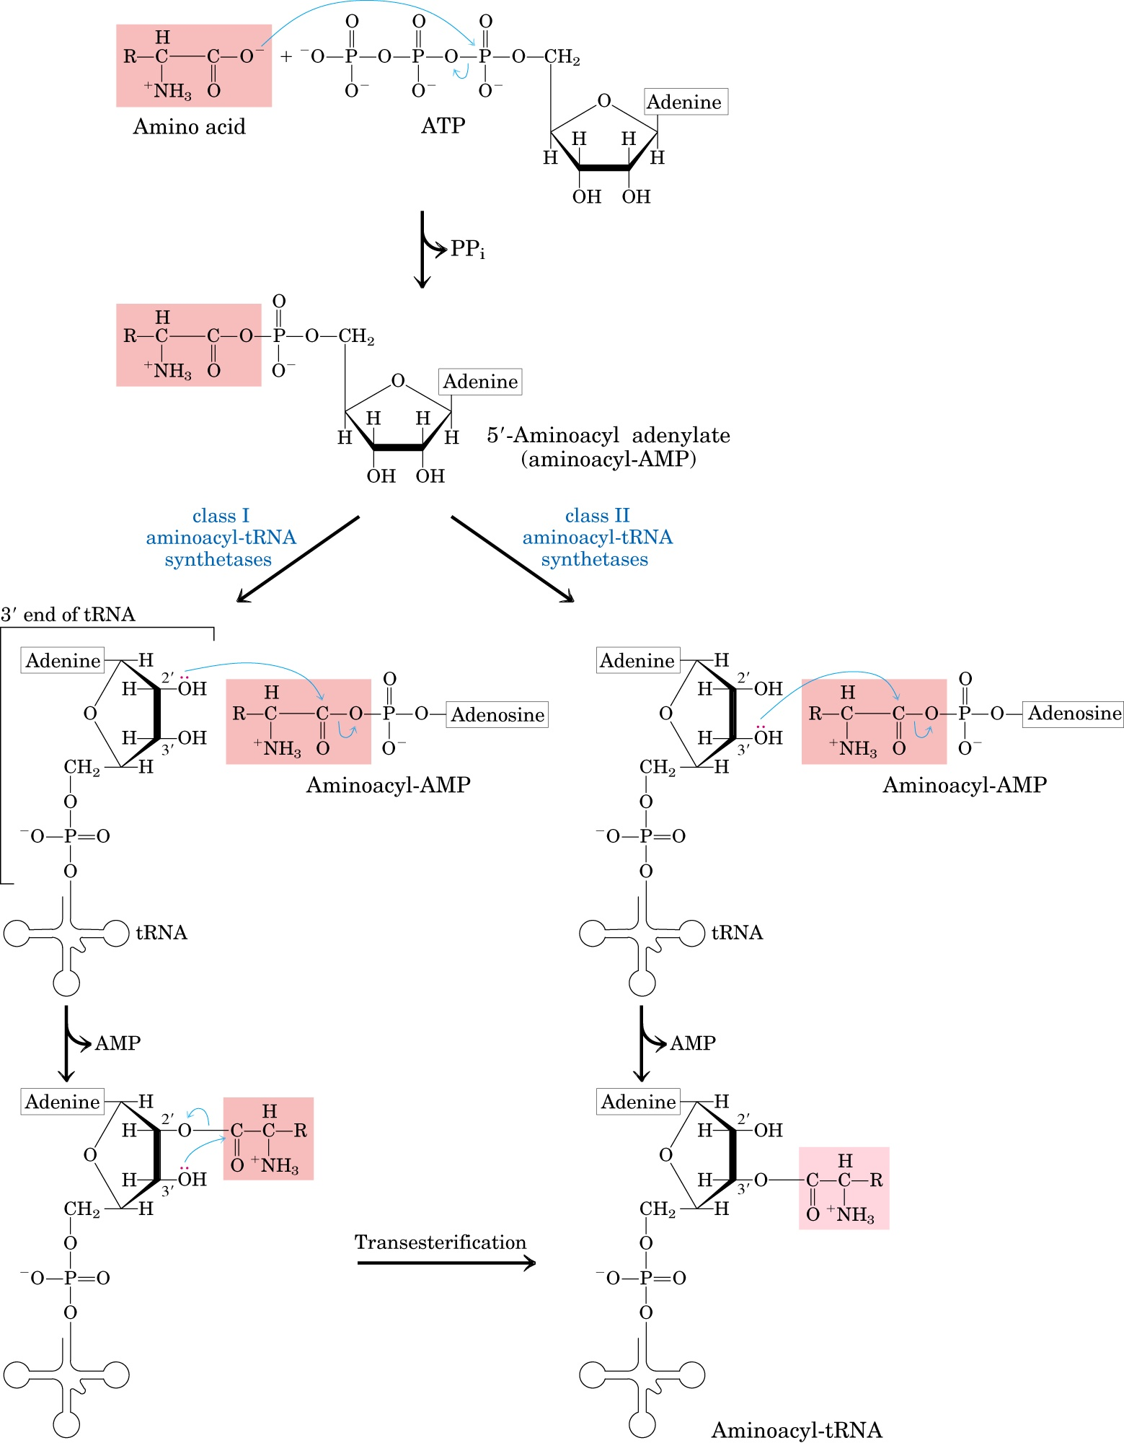

Slide 48
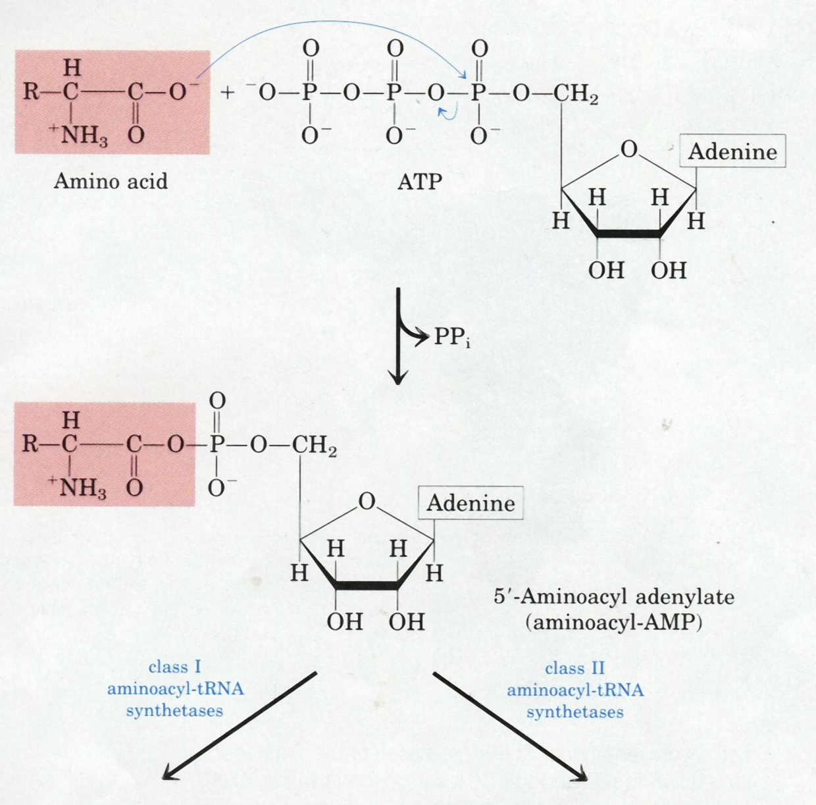
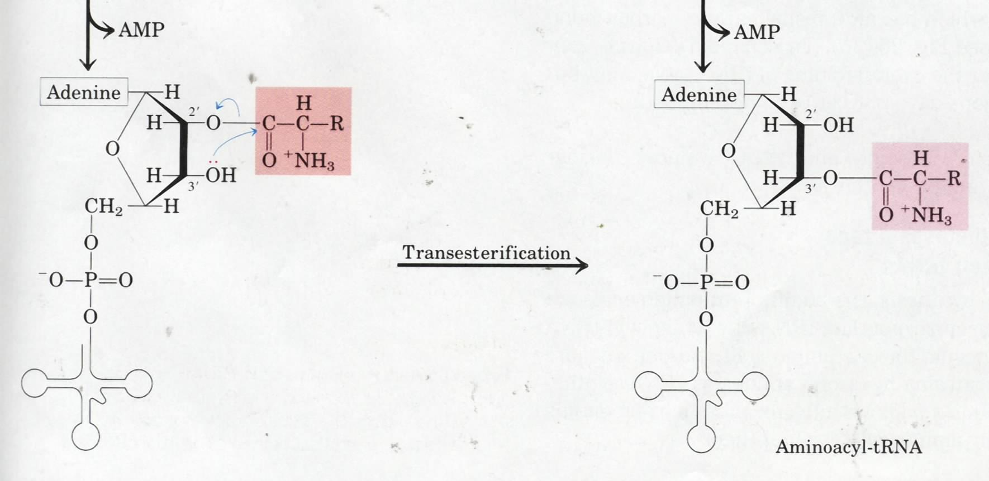
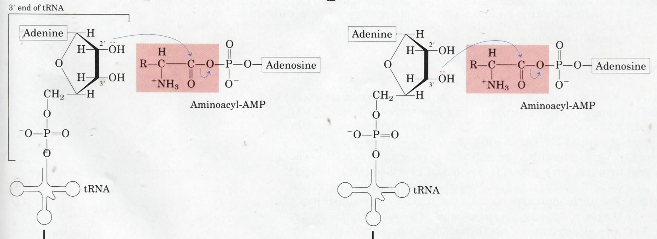
Aminoacyl-tRNA synthetases
can be divided into two classes
based on differences in structure
and reaction mechanisms.

Slide 49
(1)Amino acid + ATP aminoacyl-AMP +PPi
(2)Aminoacyl-AMP + tRNA aminoacyl-tRNA + AMP
The overall reaction is
Amino acid + ATP + tRNA aminoacyl-tRNA + AMP +PPi

Slide 50
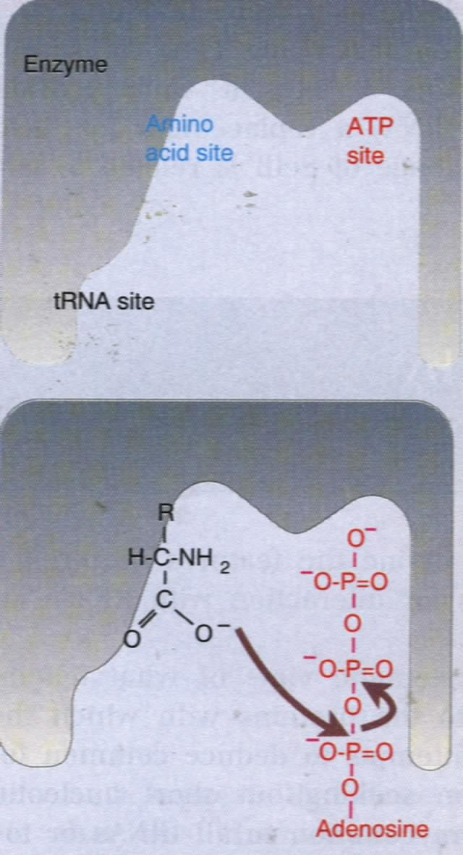
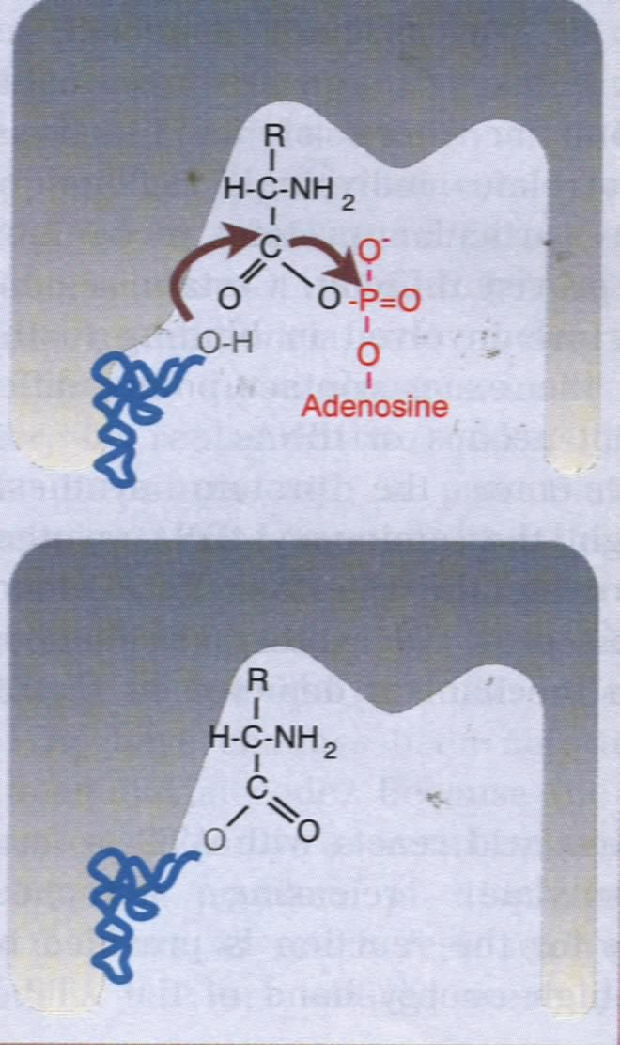
Aminoacyl-tRNA
synthetase
3 binding sites
in the active site
Aminoacyl-
tRNA

Slide 51
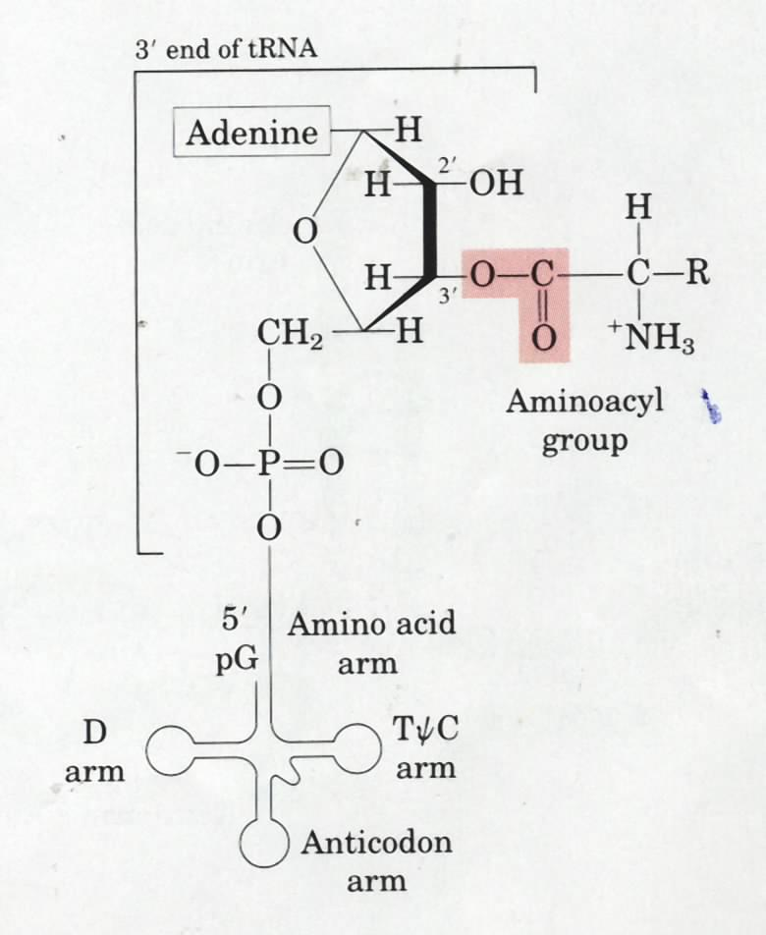
Stage 1
Each amino acid is
specifically attached
to a specific tRNA
before used for
protein synthesis

Slide 52
6. Translation in prokaryotes begins by the formation of a complex.
(Stage 2 Initiation of protein synthesis)
The Shine-Dalgarno sequence and a nearby AUG marks the start site of translation on a bacterial mRNA.

Slide 53
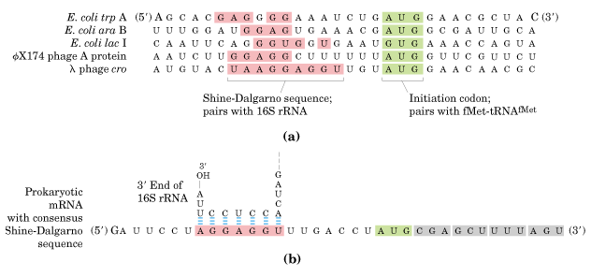
A purine-rich Shine-Dalgarno sequence and a AUG
codon marks the start site of polypeptide synthesis
on bacterial mRNA molecules.

Slide 54
This purine-rich sequence was found to be complementary to a pyrimidine-rich sequence at the 3`end of the 16S rRNA present in the 30S subunit of the ribosomes.
The Shine-Dalgarno sequence may thus serve as the ribosome binding site on bacterial mRNAs.

Slide 55
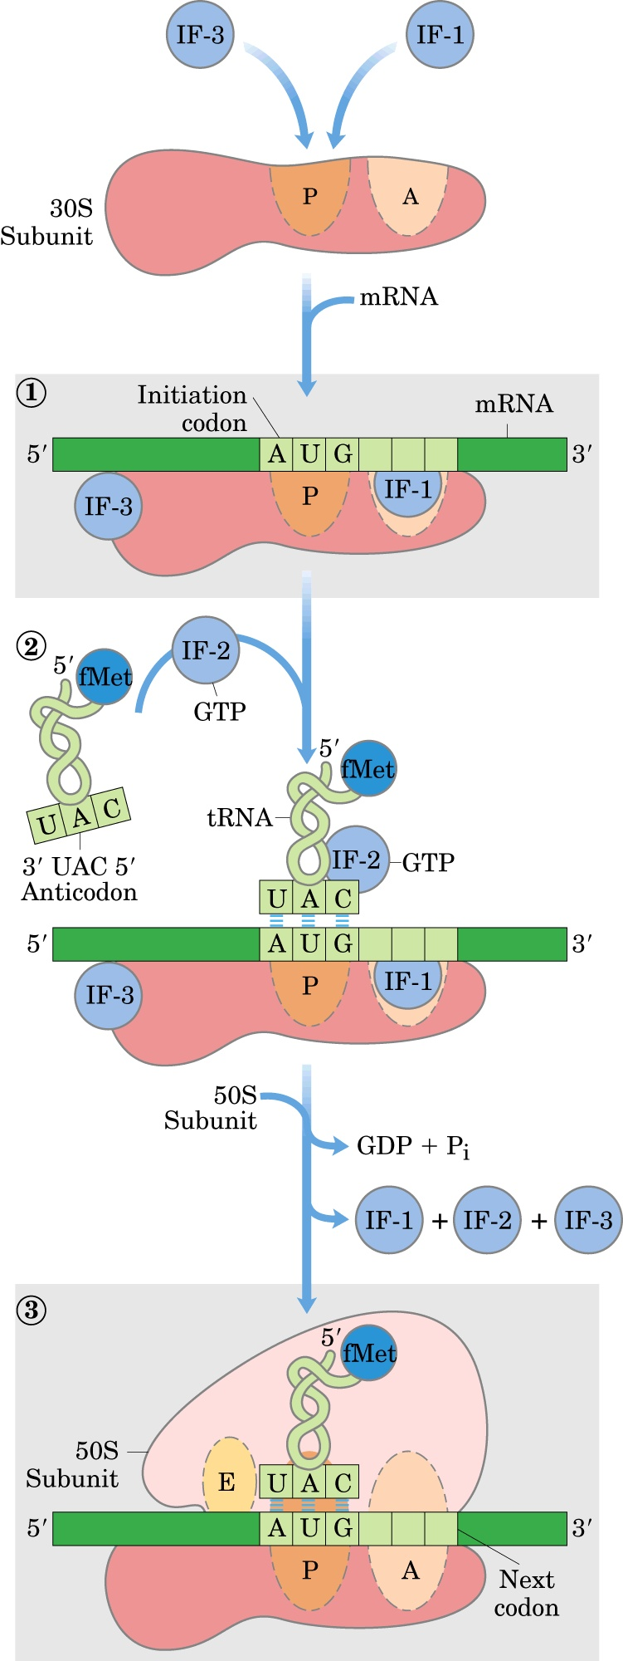
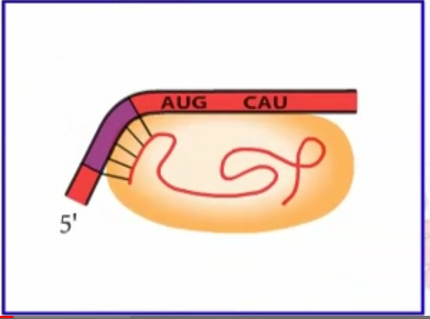
Factor IF-3 prevents the 30S and 50S subunits from combining prematurely;
Factor IF-1 binds at the A site and prevents tRNA binding at this site during initiation.

Slide 57
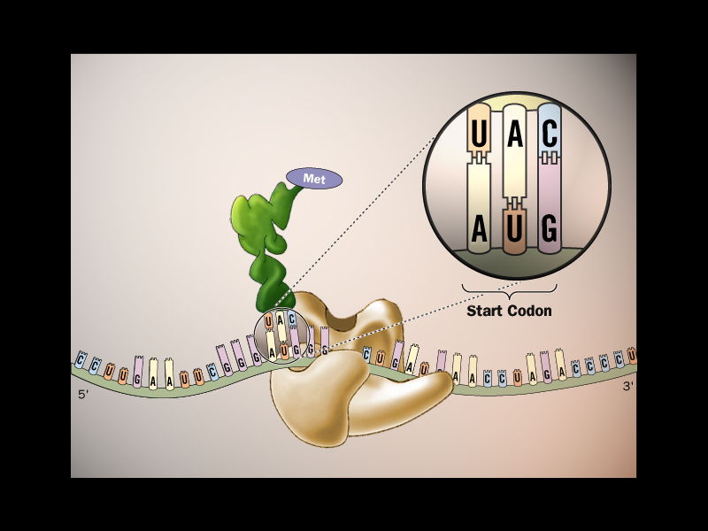
f

Slide 58
GTP bound to IF-2 is hydrolyzed to GDP and Pi, which are released from the complex. All three initiation factors depart
from the ribosome at this point.

Slide 59
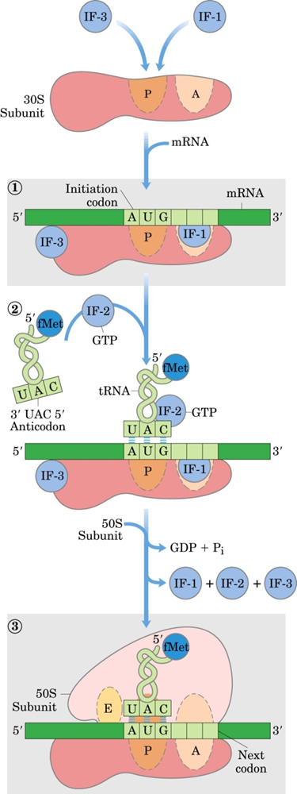
30S complex
initiation （70S）complex

Slide 60
Each prokaryotic ribosome has three binding sites for tRNA.
aminoacyl-tRNA binding site A site
peptidyl-tRNA binding site P site
exit site E site
initiation factors IFs
N-formylmethionine fMet

Slide 61
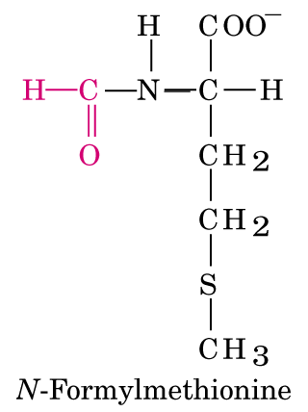
起始氨酰tRNA：
f
i
（真核生物）
蛋酰tRNA：
起始氨基酸
甲酰蛋氨酸
transformylase

Slide 62
The Met charged on tRNA^{Met} (by Met-tRNA synthetase) is specifically formylated by a transformylase to form fMet-tRNA^{fMet} in bacteria (Met-tRNA^{Met} can not be formylated).
only fMet-tRNA^{fMet} can enter the initiation site (site P) on the ribosome in E.coli.

Slide 63
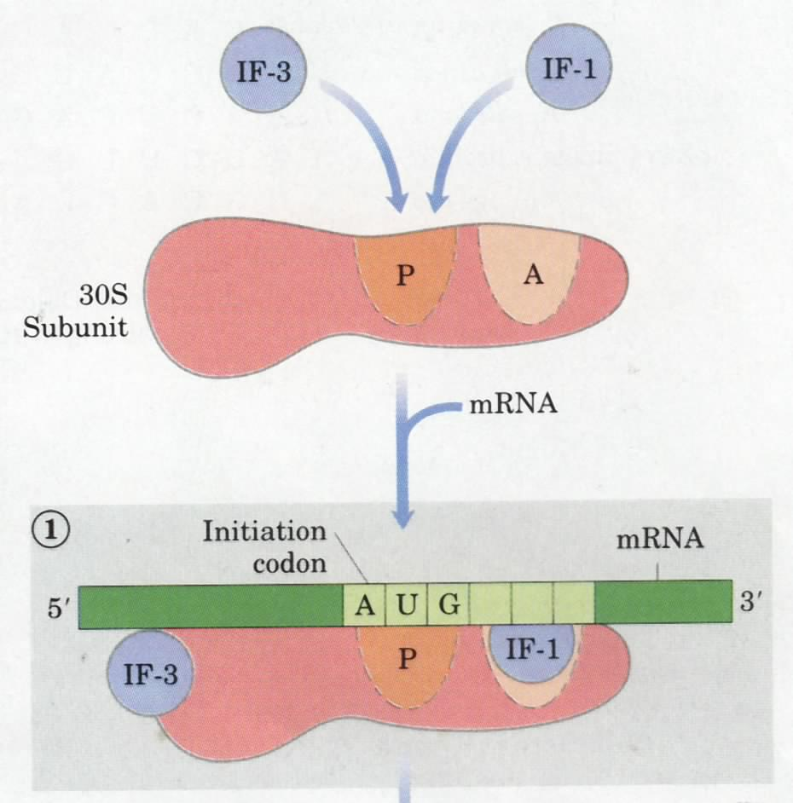
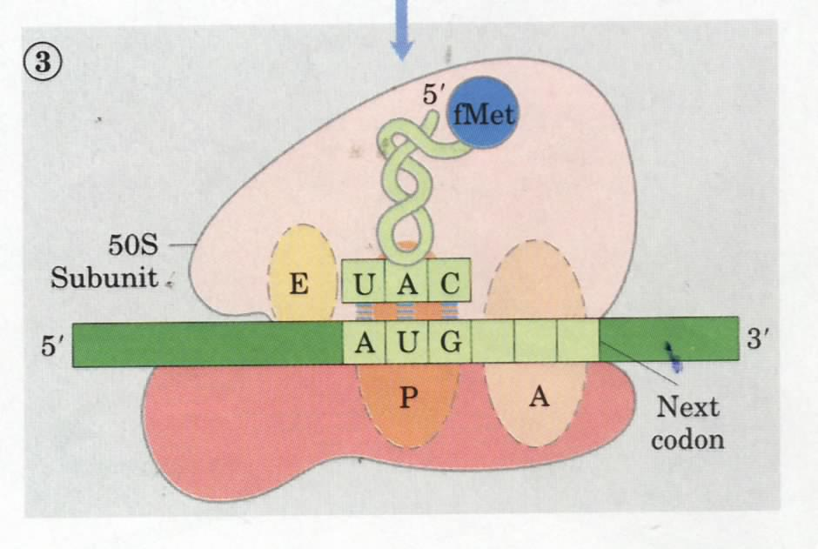
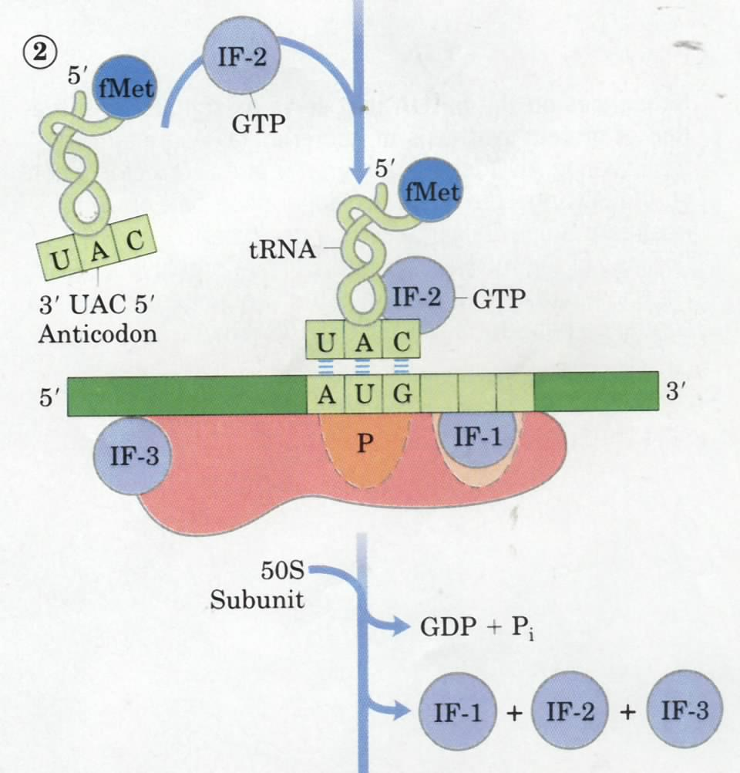
Stage 2
The initiating complex is assembled
from the small subunit of the
ribosome, the mRNA, the initiating
aminoacyl-tRNA (being
fMet-tRNA^{fMet} in bacteria), and the
large subunit of the ribosome.

Slide 64
7. The polypeptide chain is elongated via a repeating three-step reactions (stage3)
The elongation cycle consists of three steps
aminoacyl-tRNA binding （进位）
peptide bond formation （转肽）
Translocation（移位）

Slide 65
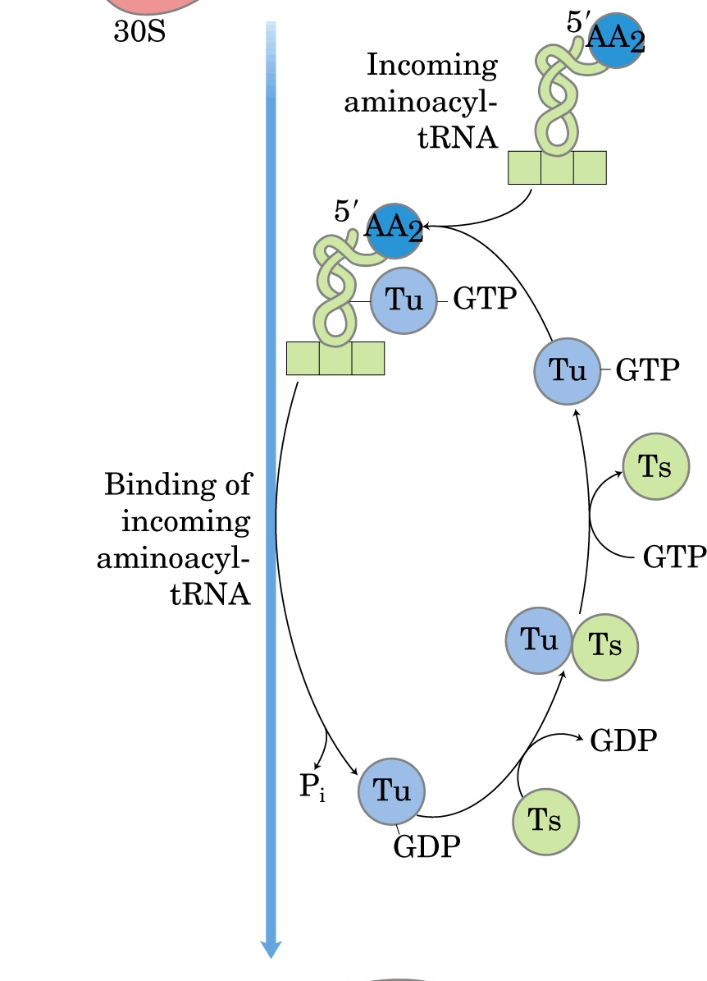

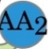
I 进位

Slide 66
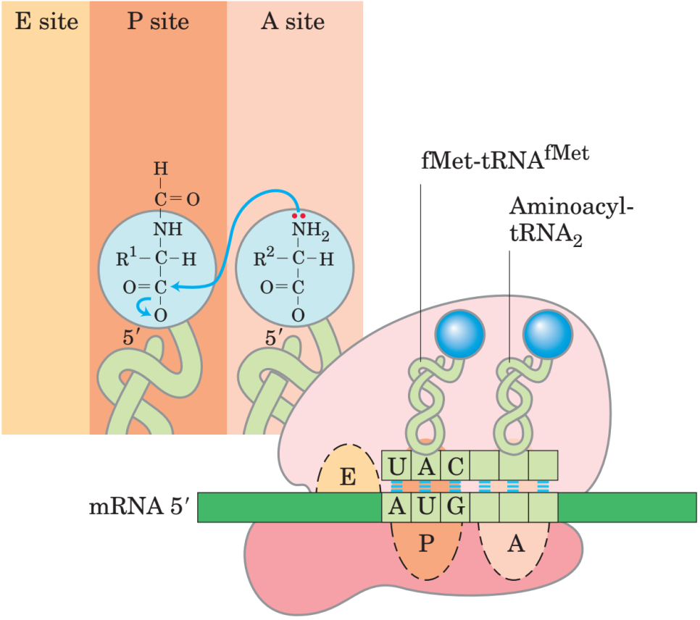
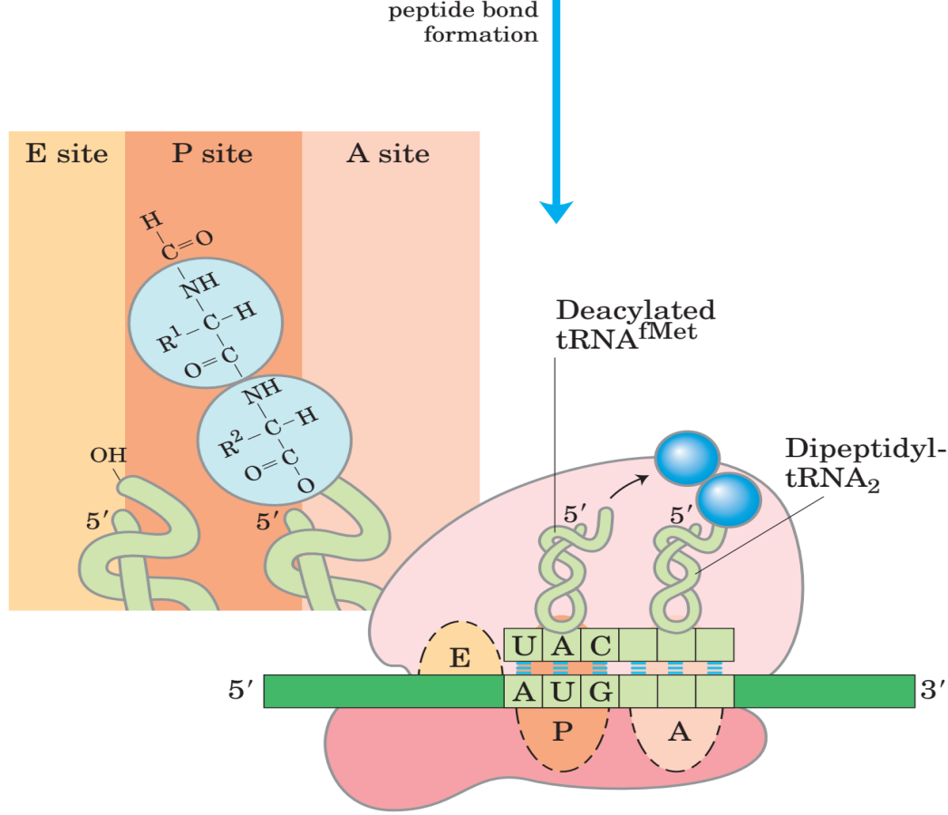
II 转肽
50S大亚基中的23S rRNA （核酶）
Peptidyl transferase
肽酰基转移酶

Slide 67
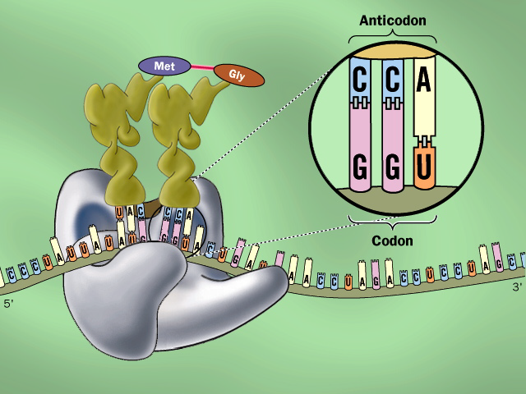
N C
f

Slide 68
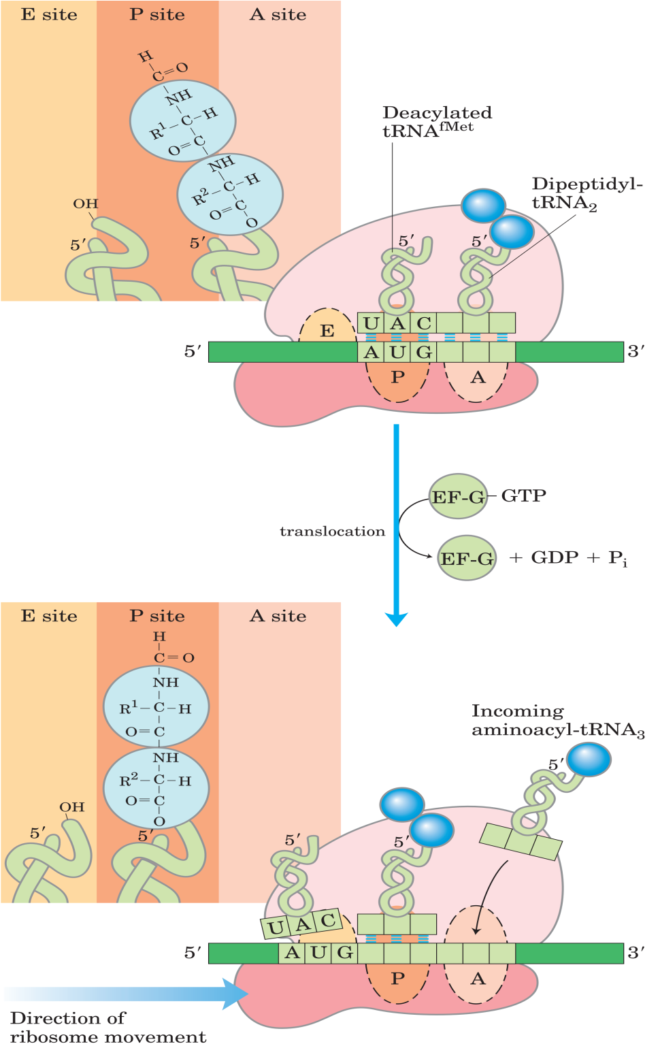
III 移位
EF-G
translocase

Slide 69
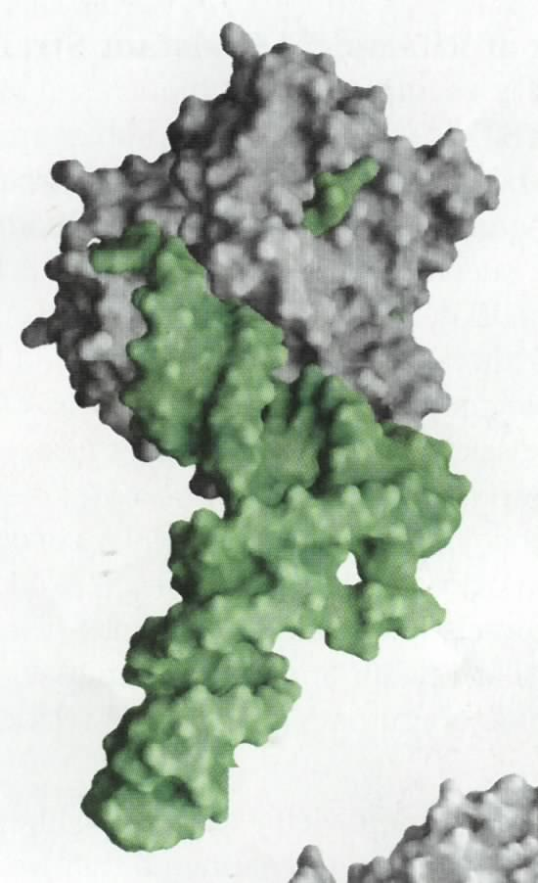
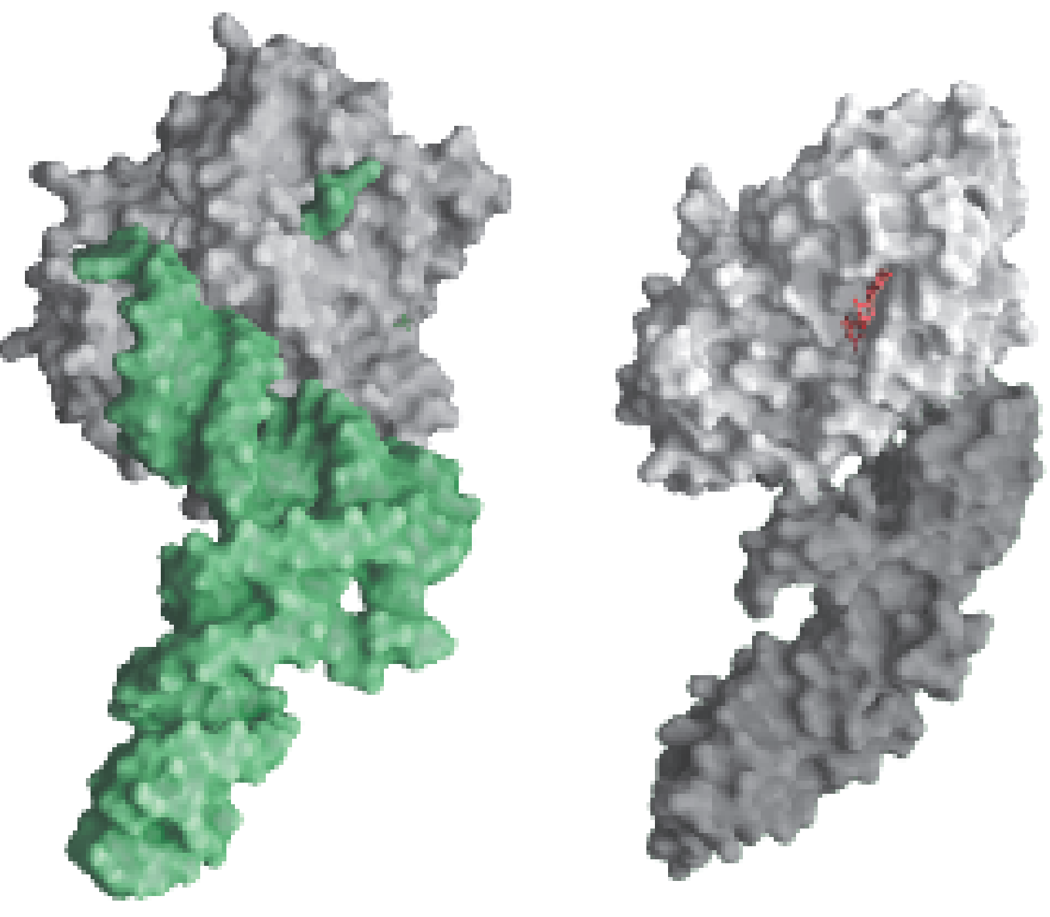
The EF-Tu-GTP-
aminoacyl-tRNA
complex
EF-Tu
GDP
Aminoacyl-tRNA
EF-G-GDP has
a structure
similar to
EF-Tu-tRNA
C terminal
of EF-G

Slide 70
The next aminoacyl-tRNA is delivered to the A (aminoacyl) site of the ribosome by EF-Tu-GTP (step 1).
The fMet group is transferred to the second aminoacyl-tRNA in the A site to form a peptide bond, generating a dipeptidyl-tRNA (step 2).The 23S rRNA of the large subunit of the ribosome seems to have the peptidyl transferase activity, thus being a ribozyme (Noller, 1992).

Slide 71
EF-G -GTP(the translocase) then promotes the translocation of the ribosome along the mRNA by the distance of one codon: the deacylated tRNA^{fMet} is released from the E (exit) site of the ribosome, the dipeptidyl-tRNA is relocated to the P site, and the A site is open for the incoming (the third) aminoacyl-tRNA (step 3).

Slide 72
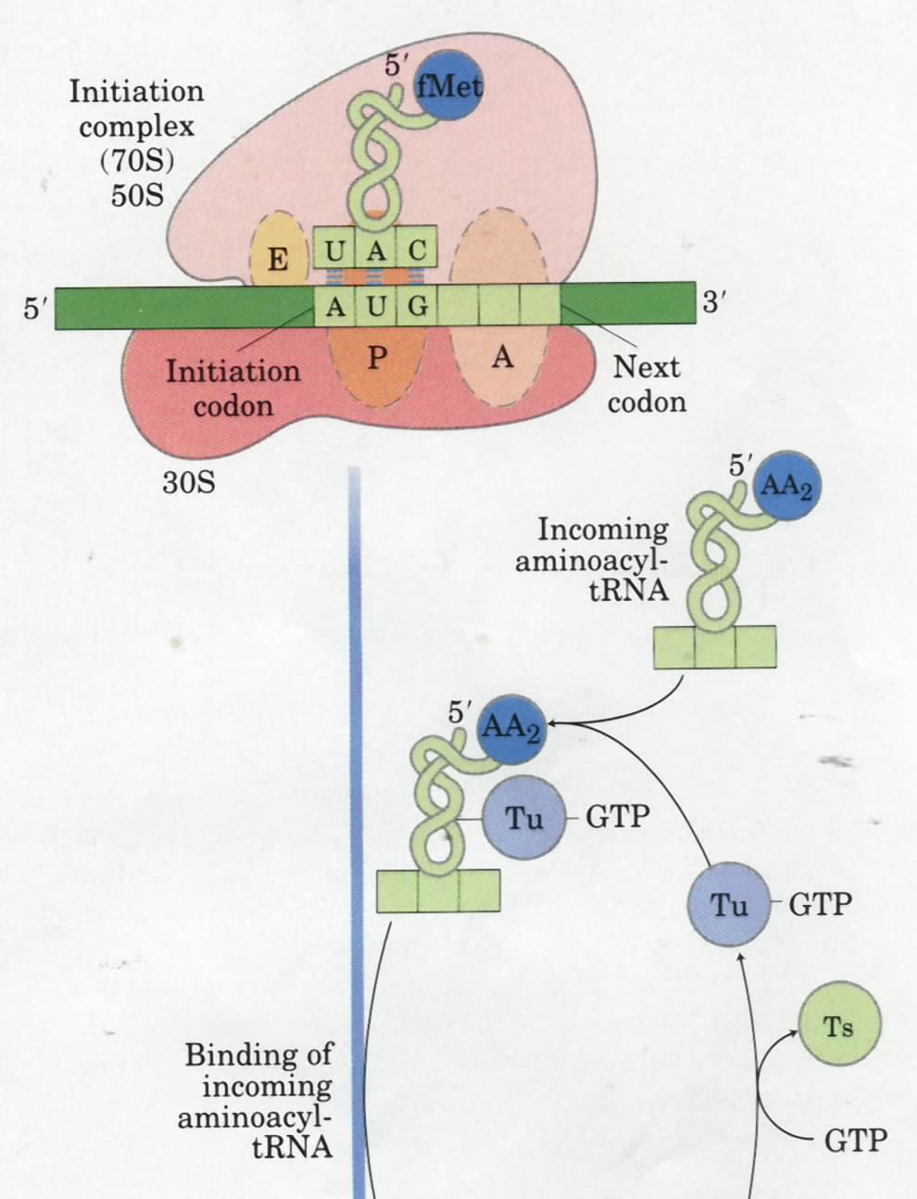
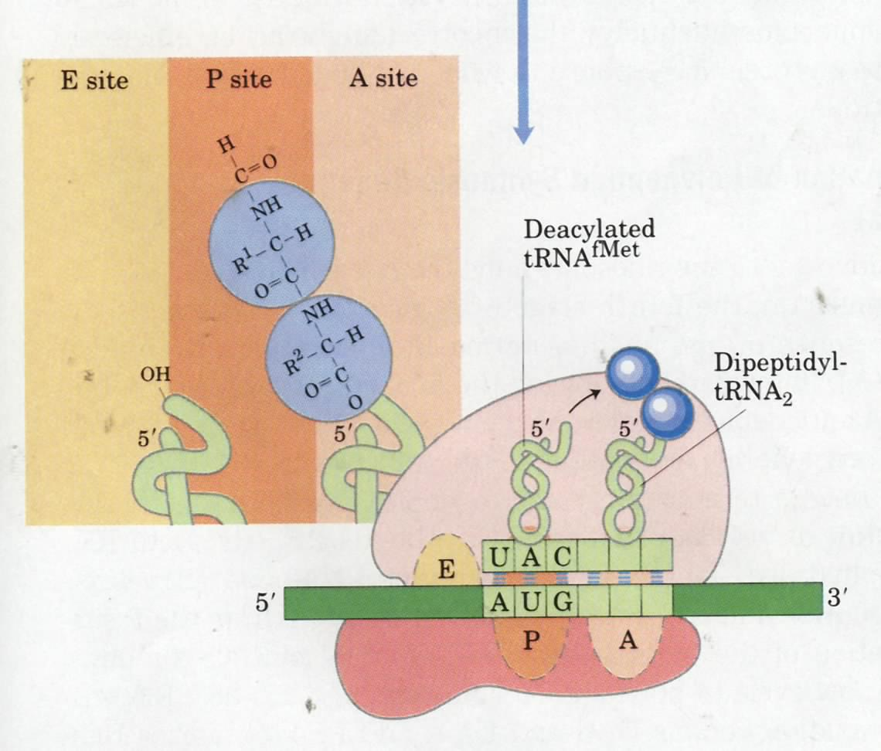
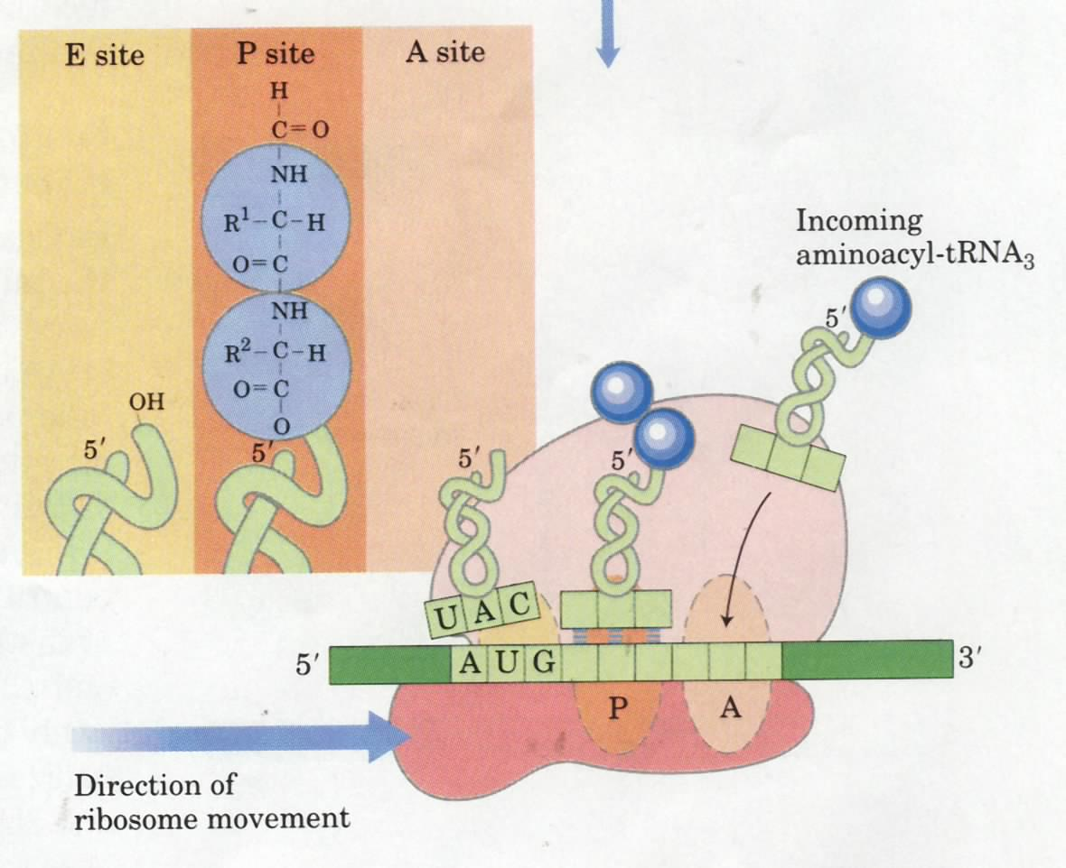
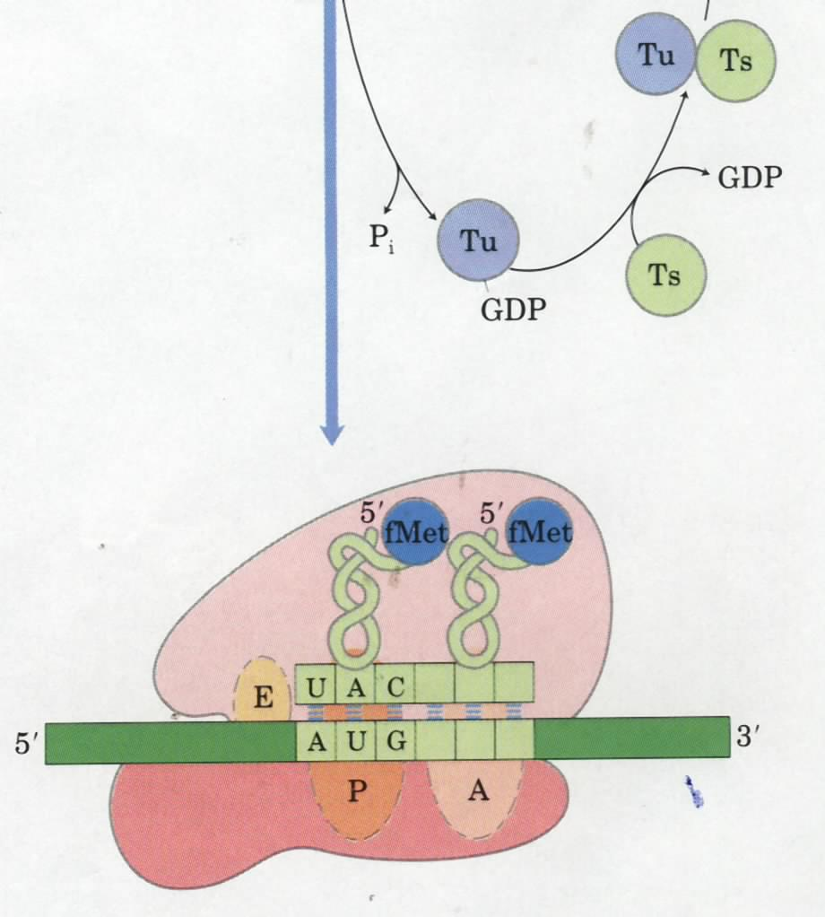
Step 2: peptide
bond formation
(23S rRNA)
Stage 3
Step 3:
Translocation
(EF-G-GTP)
Step 1:
Aminoacyl-
tRNA enters
the A site
(EF-Tu-GTP)
AA2

Slide 73


Slide 74
8. Polypeptide synthesis is terminated by release factors that read the stop codons
Two bacterial protein factors called RF1 and RF2 recognize the stop codons (RF1 for UAA and UAG; RF2 for UAA and UGA).
A third releasing factor RF3 is a GTP-binding protein and seems to act in concert to promote the cleavage of the peptide from peptidyl-tRNA.
The specificity of the peptidyl transferase (23S rRNA) is altered by the release factor: water become the acceptor of the activated peptidyl moiety.

Slide 75


The polypeptide chain is
released from the ribosome
when meeting a stop
codon (UAA, UGA, or
UGA)
Stage 4

Slide 76
9. At least four high-energy bonds are ultimately consumed for the formation of each specific peptide bond
Two for activating each amino acid (ATP AMP + 2P_{i}).
One for EF-Tu to deliver the aminoacyl-tRNA to the A site of the ribosome (GTP GDP + P_{i}).
One for EF-G to translocate the ribosome after each peptide bond is formed (GTP GDP + P_{i}).

Slide 77
10. Each mRNA is usually translated simultaneously by many ribosomes (as polysomes)
This is observed in both prokaryotic and eukaryotic cells.
The guiding effectiveness of the short-lived mRNA molecules is thus dramatically increased.
In bacteria, the translation and transcription processes are tightly coupled!

Slide 78


Slide 79


Slide 80

Polysomes are
regularly seen
in cells

Slide 81
11. Translation in eukaryotes (H3)
Eukaryotic ribosomes are larger than prokaryotic ribosomes.
At least 9 initiation factors are involved.
The initiating amino acid is Met, not fMet.
Eukaryotic mRNA do not contain SD sequences.
Eukaryotic mRNA is monocistronic (not polycistronic).
Elongation factors
Termination factors

Slide 82

31 proteins
2 rRNAs
21 proteins
1 rRNA
A prokaryotic
ribosome (70S)
An eukaryotic
ribosome (80S)
50 proteins
3 rRNAs
33 proteins
1 RNA

Slide 83

The rRNAs occupy
A large volume!
Structure of the 70S ribosome have been determined at 5.5 A!
30S
50S

Slide 84
12. The newly synthesized polypeptide chains need to be folded, assembled, and processed to make a functional protein (stage 5)
Newly synthesized polypeptide chains will assume their native conformation spontaneously or with help from other proteins (called molecular chaperones), with or without further posttranslational modifications.
Formation of disulfide bonds.
Addition of cofactors via covalent or noncovalent bonds.

Slide 85

Disulfide bonds are formed and rearranged in the ER lumen
Protein disulfide isomerase (PDI)
Notes:
85

Slide 86
The N-terminal formyl, fMet or Met may be removed enzymatically.
Signal sequences (usually 15 to 30 residues in length) at the N-terminal of some proteins will be removed by specific peptidases after the protein reached their cellular destinations (protein targeting).
Proteolytic cleavage of larger precursor proteins.

Slide 87
The N-terminal amino and C-terminal carboxyl groups may be modified (e.g., acetylated).
Specific amino acids in a protein may be enzymatically modified posttranslationally by groups like phosphate, carboxylate，or methylate.
Oligosaccharide groups are covalently attached to specific Asn, Thr, or Ser residues in some proteins (glycoproteins, often function extracellularly).

Slide 88
Epigenetics
-histone methylation
Histone 3 methylation | function
H3K4me3 | Gene activation （protein coding gene）
H3K9me3 | Gene repression （transposon）
H3K27me3 | Gene repression （protein coding gene）

Slide 89


Slide 90



Slide 91
Epigenetics
-histone methylation
Histone 3 methylation | function
H3K4me3 | Gene activation （protein coding gene）
H3K9me3 | Gene repression （transposon）
H3K27me3 | Gene repression （protein coding gene）
Euchromatin
Heterochromatin
Euchromatin

Slide 92
Summary
Genetic and biochemical studies showed that the genetic codes are continuous triplets of nucleotides.
The genetic codes was deciphered within five years using artificial mRNA templates of various base composition, in vitro protein synthesis and filter binding assays.
A tRNA molecule can recognize one to three codons depending what the first (wobble) nucleotide of the anticodon is (C and A for one, U and G for two, I for three).
In certain viral DNAs, overlapping genes are found.

Slide 93
Protein synthesis occurs on ribosomes: having a large and small subunits, both composing one or two rRNA and many protein molecules.
Protein synthesis can be divided into five stages:
activation of amino acids (ATP dependent, aminoacyl-tRNA synthetase catalyzed);
formation of the initiation complex at the ribosome binding site and initiation codon (helped by specific initiation protein factors, IF-1, 2, and 3);
elongation of the peptide chain (helped by the elongation factors, EF-Tu, EF-Ts, EF-G and catalyzed by the 23S rRNA);
termination (helped by the releasing factors, RF₁, RF₂, and RF₃);
folding and posttranslational modifications.

Slide 94
H4 Protein Targeting

Slide 95
How does a protein get to the correct cellular location?
Proteins are targeted to different compartments in different ways.
Notes:
95

Slide 96

Notes:
96

Slide 97

Protein Targetting
Ribosome
ER
Bound
Free
Lysosomal
Secretory
Plasma Memb.
Soluble Proteins
Nucleus
Mitochondria
Chloroplasts
peroxisomes

Slide 98
Proteins that are targeted to the cell surface, Golgi and Lysosomes are synthesized on ER membrane bound ribosomes and move through the secretory pathway.
Proteins that are targeted to the nucleus, mitochondria, chloroplasts and peroxisomes are synthesized on free ribosomes as soluble polypeptides.
Notes:
98

Slide 99


Slide 100
Protein Targeting:
How do secreted proteins get to the ER membrane?
Gunther Blobel
Nobel Prize 1999
"for the discovery that proteins have intrinsic signals that govern their transport and localization in the cell"
Notes:
100

Slide 101


Slide 102

Early experiments: An N-terminal signal sequence on nascent secretory proteins targets synthesis to the ER and is then cleaved.
Translation of secretory mRNA’s in cell free protein synthesis system produces full length proteins with intact signal sequence
Adding microsomes (ER membranes) to system causes ribosomes to bind to membranes, translocation of the protein to the lumen and cleavage of signal sequence
Notes:
102

Slide 103

Signal sequences usually contain 1 or more + charged amino acids followed by a stretch of hydrophobic residues
Signal sequences vary in length from 13 to 36 amino acid residues, but all have the following features:
10 to 15 hydrophobic amino acid residues;
one or more positively charged residues（basic residues）,usually near the amino terminus;
An amino acid residues with short side chains (especially Ala) at the positions closest to the cleavage site.
Notes:
103

Slide 104
The ER targeting mechanism requires two special receptor proteins:
What gets the ribosomes with secretory protein mRNA's to bind to the ER membranes?
1. Signal recognition particle (SRP)
2. SRP receptor
Notes:
104

Slide 105

Translation of secretory mRNA begins on free ribosomes
N-terminal signal sequence emerges from ribosome tunnel
Signal recognition particle (SRP) binds to the emerging signal sequence from the ribosome
Notes:
105

Slide 106
SRP receptor initiates the interaction of signal sequences with the ER membrane
Notes:
106

Slide 107
Secretory proteins move from the Rough ER lumen through Golgi complex and then to cell surface by vesicle mediated transport
Notes:
107

Slide 108
Notes:
108

Slide 109


Slide 110
All proteins encoded by nuclear DNA are first translated on free cytoplasmic ribosomes
Soluble proteins and proteins targeted to the mitochondria, chloroplasts and peroxisomes are completely synthesized on free ribosomes
Translation of Integral membrane proteins, secreted proteins, and proteins in the ER, Golgi, and lysosomes are synthesized on ribosomes bound to the ER membrane
The subunits on free and ER bound ribosomes are identical
Notes:
110

Slide 111
Most proteins synthesized in the Rough ER are glycosylated by a core oligosaccharide.
H5 Protein Glycosylation
Notes:
111

Slide 112

Proteins are Glycosylated in ER and Golgi
Asn-[X]-Ser/Thr
-important for folding
-important for function
-important for targeting
乙酰氨基葡萄糖

Slide 113

N-linked on Asn and O-linked on Ser/Thr
Pyrophosphate

Slide 114


N-连接：
连接方式
O-连接：
The glycosylation signal is Asn-X- (Ser/Thr)

Slide 115

Core Glycosylation and Trimming in the ER lumen
Oligosaccharide Transferase
Notes:
115

Slide 116
The core oligosaccharide used for N-linked glycosylation is assembled onto the polyisoprenoid lipid, dolichol pyrophosphate.
Notes:
116

Slide 117
END
Thank you

Slide 118
All 64
genetic
codes
可能的反密码子
GAA
CGA
GUA
GCA
UAA
IGA
CCA
CGG
CCG
IGG
GUG
CAG
IAG
UUG
ICG
IAU
CGU
GUU
IGU
GCU
UUU
CAU
UCU
CGC
GUC
CAC
IGC
CCC
IAC
ICC
UUC

Slide 119
All 64
genetic
codes
GUA
IAA
IUA
ICA
IGA
UAA
CAA
CGA
ACC
IAG
IUG
IGG
ICG
UUG
CAC
CGG
CCG
IAU
IUU
IGU
GCU
UUU
CGU
UCU
CAU
IUC
IAC
IGC
ICC
UUC
CAC
CGC
CCC

